Slide 1
Slopes and Equations of Lines

Slide 2

Slope
The ratio of the change along the y-axis to the change along the x-axis between any two points on the line.
Rate of change
Change in y over change in x

Slide 3
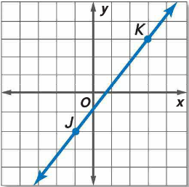
Examples

Slide 4
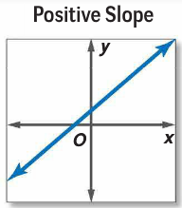
Slope

Slide 5
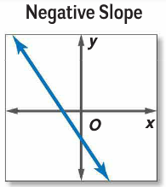
Slope

Slide 6
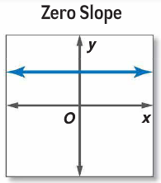
Slope

Slide 7
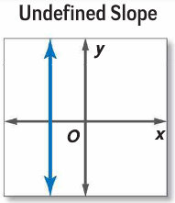
Slope

Slide 8
Slopes of Parallel Lines
Two nonvertical lines have the same slope if and only if they are parallel. All vertical lines are parallel

Slide 9
Slopes of Perpendicular Lines
Two nonvertical lines are perpendicular if and only if the product of their slopes is -1. Vertical and horizontal lines are perpendicular.

Slide 10
Examples
Determine whether lines AB and CD are parallel, perpendicular, or neither.
A(14, 13), B(-11,0), C(-3,7), D(-4-5)

Slide 11
Examples
Determine whether lines AB and CD are parallel, perpendicular, or neither.
A(14, 13), B(-11,0), C(-3,7), D(-4-5)
m_{AB}= 13/25; m_{CD}= 12/1
neither

Slide 12
Examples
Determine whether lines AB and CD are parallel, perpendicular, or neither.
A(3, 6), B(-9,2), C(5,4), D(2,3)

Slide 13
Examples
Determine whether lines AB and CD are parallel, perpendicular, or neither.
A(3, 6), B(-9,2), C(5,4), D(2,3)
m_{AB}= 4/12 = 1/3; m_{CD}= 1/3
Same slope→parallel

Slide 14
Equations of Lines
Slope-intercept form: y=mx+b; m is slope, b is y-intercept
Point-slope form: y-y1=m(x-x1); m is slope

Slide 15
Examples
Slope and Y-intercept:
Write an equation in slope-intercept form of the line with slope 4 and y-intercept of -7.

Slide 16
Examples
Slope and Y-intercept:
Write an equation in slope-intercept form of the line with slope 4 and y-intercept of -7.
y = 4x - 7

Slide 17
Examples
Slope and a Point on the Line
Write an equation in point-slope form of the line with slope -2/3 and passes through the point (4,-2).

Slide 18
Examples
Slope and a Point on the Line
Write an equation in point-slope form of the line with slope -2/3 and passes through the point (4,-2).
y = -2x/3 + 2/3

Slide 19
Examples
Two Points
Write an equation in slope-intercept form of the line through points (2,5) and (-7,-9).

Slide 20
Examples
Two Points
Write an equation in slope-intercept form of the line through points (2,5) and (-7,-9).
m = 14/9; b = 17/9
y = 14x/9 + 17/9

Slide 21
Horizontal and Vertical Lines
The equation of a horizontal line is y=b, where b is the y-intercept of the line.
y=3
The equation of a vertical line is x=a, where a is the x-intercept of the line.
x=-4

Slide 22
Examples
Write an equation in slope-intercept form for a line perpendicular to y=-2x+6 containing (3,2).

Slide 23
Examples
Write an equation in slope-intercept form for a line perpendicular to y=-2x+6 containing (3,2).
m = ½
y = x/2 + ½

Slide 24
Examples
Write an equation in slope-intercept form for a line parallel to y = 4x - 5 containing (-1,5).

Slide 25
Examples
Write an equation in slope-intercept form for a line parallel to y = 4x - 5 containing (-1,5).
m = 4
y = 4x + 9

