Slide 1
Geometric Probability
Lesson 13-3

Slide 2
Geometric Probability
Geometric probability is a probability that involves a geometric measure such as length or area.

Slide 3
Length Probability Ratio
If a line segment(1) contains another segment(2) and a point on segment(1) is chosen at random, then the probability that the point is on the segment(2) is

Slide 4

Example
Point L is chosen at random on RS. Find the probability of each event.
1. P(L is on TV)

Slide 5
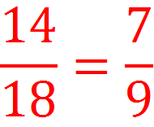

Answer
Point L is chosen at random on RS. Find the probability of each event.
1. P(L is on TV)

Slide 6
Example
Point L is chosen at random on RS. Find the probability of each event.
2. P(L is on US)

Slide 7


Answer
Point L is chosen at random on RS. Find the probability of each event.
2. P(L is on US)

Slide 8
Example
Point L is chosen at random on RS. Find the probability of each event.
3. P(L is on RT)

Slide 9


Answer
Point L is chosen at random on RS. Find the probability of each event.
3. P(L is on RT)

Slide 10
Area Probability Ratio
If a region A contains a region B and a point E in Region A is chosen at random, then the probability that point E is in region B is

Slide 11

example
Find the probability that a point chosen at random lies in the shaded region.

Slide 12
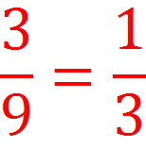

Answer
Find the probability that a point chosen at random lies in the shaded region.

Slide 13
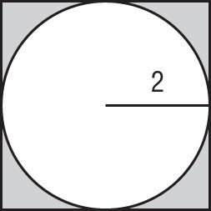
Example
Find the probability that a point chosen at random lies in the shaded region.

Slide 14

Answer
Find the probability that a point chosen at random lies in the shaded region.

Slide 15
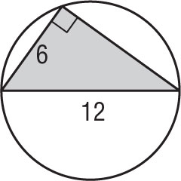
Example
Find the probability that a point chosen at random lies in the shaded region.

Slide 16

Answer
Find the probability that a point chosen at random lies in the shaded region.

Slide 17
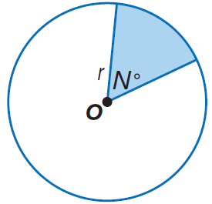
“Angle Probability Ratio”
The ratio of the area of a sector of a circle to the area of the entire circle is the same as the ratio of the sector’s central angle to 360.

Slide 18
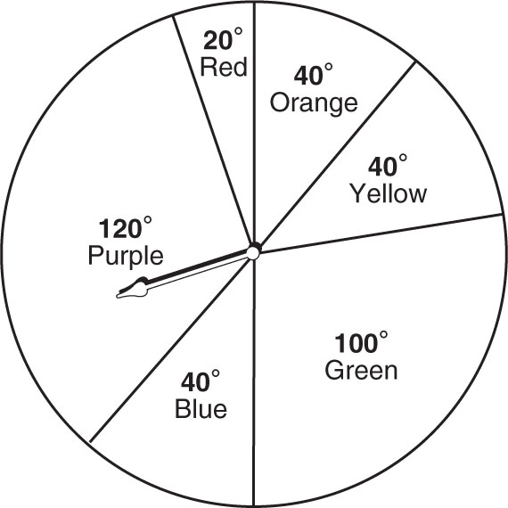
example
Use the spinner to find each probability. If the spinner lands on a line it is spun again.
P(pointer landing on purple)

Slide 19
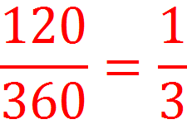
answer
Use the spinner to find each probability. If the spinner lands on a line it is spun again.
P(pointer landing on purple)

Slide 20
Example
Use the spinner to find each probability. If the spinner lands on a line it is spun again.
P(pointer landing on red)

Slide 21
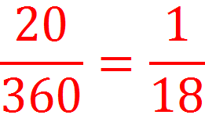
answer
Use the spinner to find each probability. If the spinner lands on a line it is spun again.
P(pointer landing on red)

Slide 22
Example
Use the spinner to find each probability. If the spinner lands on a line it is spun again.
P(pointer landing on yellow)

Slide 23
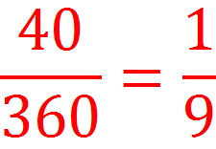

answer
Use the spinner to find each probability. If the spinner lands on a line it is spun again.
P(pointer landing on yellow)

