Slide 1
Solving Equations Related To Square Root Functions

Slide 2
Solving Equations Related To Square Root Functions
A square root function is the inverse of a quadratic function. In order for the square root relationship to be a function, there is a domain restriction on the related quadratic function that results in a range restriction for the square root function.
An equation that is related to a given function, f(x), is one in which the value of the dependent variable is known and you need to determine the value(s) of the independent variable that generates it. For a square root function, there will only be one pair of values for which this is true.

Slide 3
Solving Equations Related To Square Root Functions
Graphically, locate a point on the graph of f(x) that has a y-coordinate equal to the given function value. The x-coordinate of this point is the x-value paired with that function value. This x-value is the solution to the equation.

Slide 4
Solving Equations Related To Square Root Functions
Tabularly, locate the function value in the dependent variable column or row. The value in the independent variable column or row associated with this function value is the solution to the equation.

Slide 5
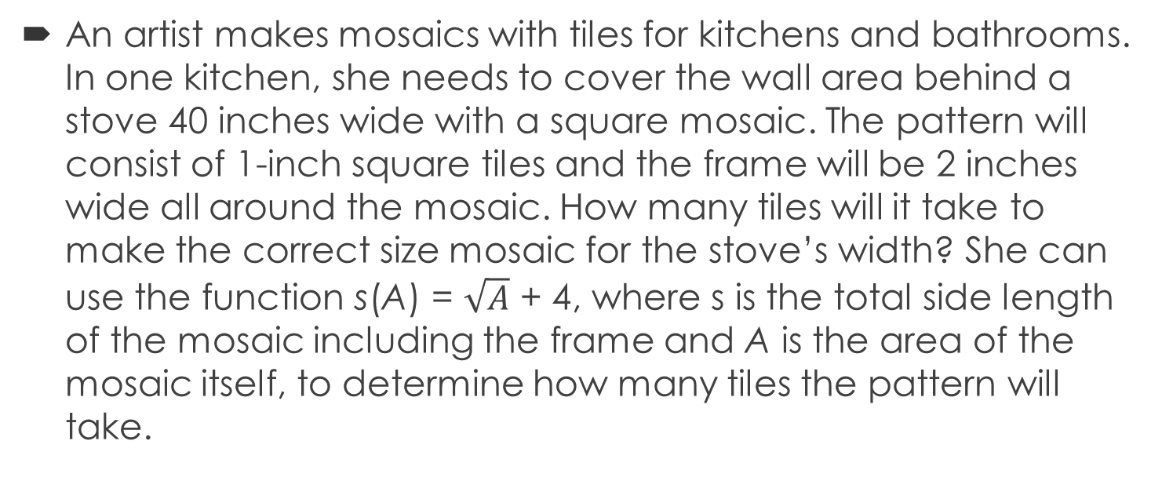
Examples
An artist makes mosaics with tiles for kitchens and bathrooms. In one kitchen, she needs to cover the wall area behind a stove 40 inches wide with a square mosaic. The pattern will consist of 1-inch square tiles and the frame will be 2 inches wide all around the mosaic. How many tiles will it take to make the correct size mosaic for the stove’s width? She can use the function s(A) = $\sqrt{A}$ + 4, where s is the total side length of the mosaic including the frame and A is the area of the mosaic itself, to determine how many tiles the pattern will take.

Slide 6
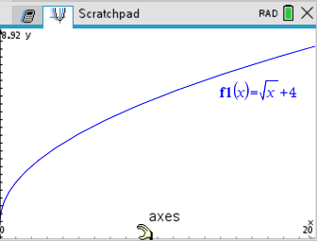
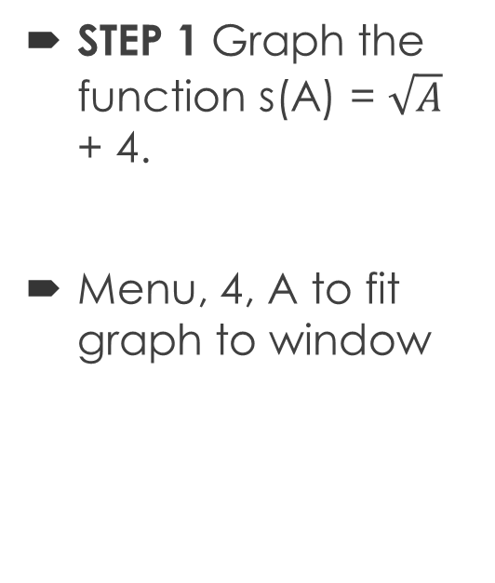
Examples
STEP 1 Graph the function s(A) = $\sqrt{A}$ + 4.
Menu, 4, A to fit graph to window

Slide 7

Examples
STEP 2 Write an equation related to the function with the required side length, s, of 40 inches.
40 = $\sqrt{A}$ + 4

Slide 8
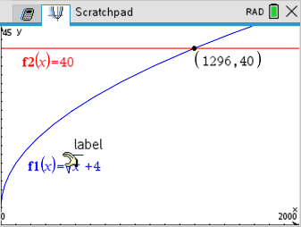
Examples
STEP 3 Graph y = 40 on the same grid with the function and use the coordinates of the intersection point to answer the question, “How many tiles will the pattern take?”
Make sure to change the window to see the new graph

Slide 9
Examples
The intersection point is (1296, 40). So the artist will use 1,296 tiles to make the pattern.

Slide 10
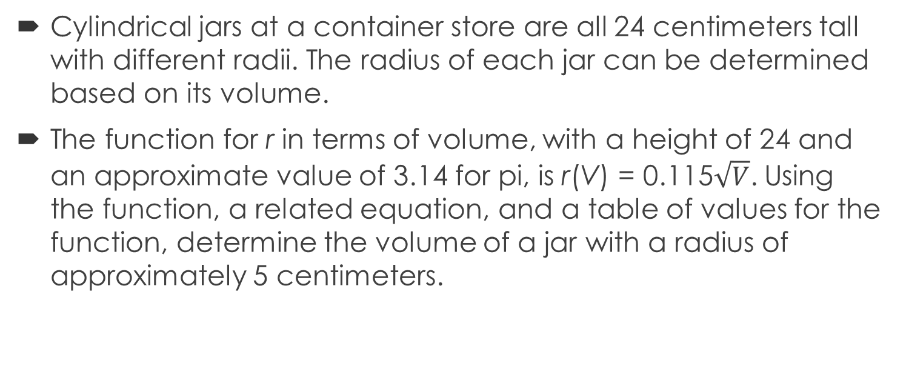
Examples
Cylindrical jars at a container store are all 24 centimeters tall with different radii. The radius of each jar can be determined based on its volume.
The function for r in terms of volume, with a height of 24 and an approximate value of 3.14 for pi, is r(V) = 0.115$\sqrt{V}$. Using the function, a related equation, and a table of values for the function, determine the volume of a jar with a radius of approximately 5 centimeters.

Slide 11

Examples
STEP 1 Write a related equation for the function r(V ) = 0.115$\sqrt{V}$.
5 = 0.115$\sqrt{V}$

Slide 12
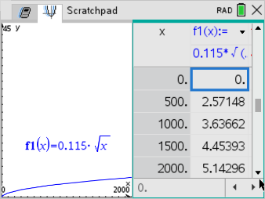
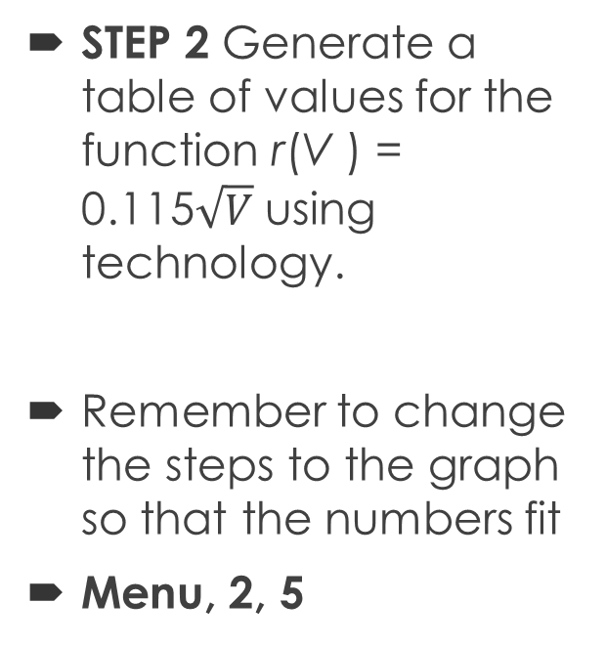
Examples
STEP 2 Generate a table of values for the function r(V ) = 0.115$\sqrt{V}$ using technology.
Remember to change the steps to the graph so that the numbers fit
Menu, 2, 5

Slide 13
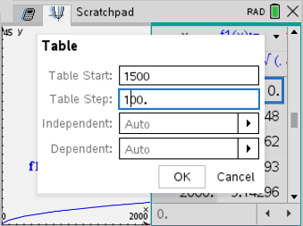
Examples
STEP 3 Since a radius of 5 is between 4.45 and 5.14, generate a new table of input values between 1,500 and 2,000, decreasing the interval of 500 to 100.

Slide 14
Examples
STEP 4 Interpret the values in the table.
For the function value of 5.01, there is an input value of 1900. A jar with a radius of 5 centimeters will have a volume of approximately 1,900 cubic centimeters.

