Slide 1
Solving Equations Related To Exponential Functions

Slide 2
Solving Equations Related To Exponential Functions
An exponential function has a base, which is a constant multiplier, and a power that contains the variable.
An equation that is related to a given function, f(x), is one in which the value of the dependent variable is known and you need to determine the value(s) of the independent variable that generates it.
For an exponential function, there will only be one pair of values for which this is true.

Slide 3
Solving Equations Related To Exponential Functions
Graphically, locate a point on the graph of f(x) that has a y-coordinate equal to the given function value. The x-coordinate of this point is the x-value paired with that function value. This x-value is the solution to the equation.

Slide 4
Solving Equations Related To Exponential Functions
Tabularly, locate the function value in the dependent variable column or row. The value in the independent variable column or row associated with this function value is the solution to the equation.

Slide 5
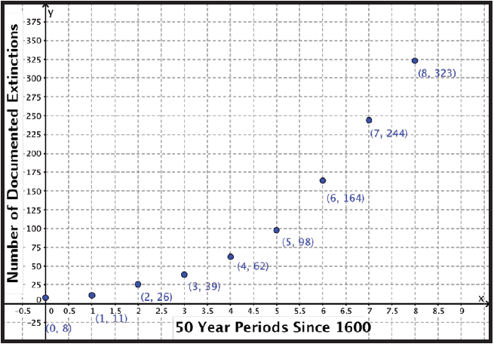
Examples
Historical records of animal species extinctions have been kept since the 16th century. The graph shows the total number of documented extinctions that have taken place in 50-year time spans since the year 1600.

Slide 6
Examples
A researcher notes that the historical trend of an increase of about 62.8% per 50-year period can best be approximated as h(x) = 8(1.628)^{x}, where x represents the number of 50 year periods since the year 1600 and h(x) represents the total number of documented extinctions. If the trend continues, in what year does the model predict there are 350 documented species extinctions? Write an equation related to h(x) and approximate the solution graphically.

Slide 7
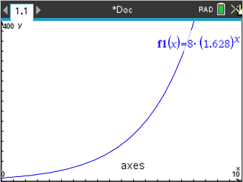
Examples
Step 1 Type the equation in the function editor
In the calculator:
Add Graph
Type 8(1.628)^{x}
Make sure to change the window settings if necessary to see the full graph (use settings from previous graph)

Slide 8
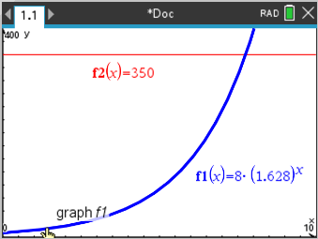
Examples
Step 2 Since the prediction is for 350 documented species, make a second equation equal to 350
In the calculator
tab 350

Slide 9
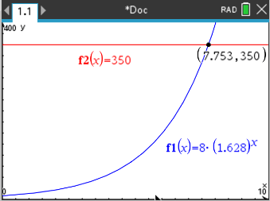
Examples
Step 3 Determine the point of intersection between the two equations
Menu, 6, 4
Get the lower and upper bounds

Slide 10
Examples
Step 4 Interpret the intersection point in terms of the situation
A value of x = 7.753 means that the model predicts that there are 350 documented species extinctions in the year 1600 + 7.753(50) = 1987.65. Convert 0.65 years to months: 0.65(12) = 7.8 or approximately 8 months.
The equation 350 = 8(1.628)x will yield the year in which the model predicts there will be 350 documented species extinctions. The model h(x) predicts that there are 350 documented species extinctions in August of 1987.

Slide 11
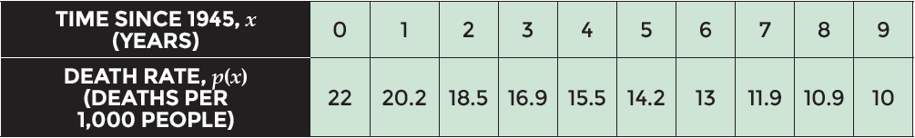
Examples
Before World War II, Sri Lanka had a public health crisis due to a large population of mosquitos that caused malaria outbreaks, increasing human death rates. After 1945, insect repellents were widely used that controlled the mosquito population, and the human death rate in Sri Lanka dropped by about 8.4% annually. The function p(x) = 22(0.916)^{x} represents the death rate in number of deaths per 1,000 people in the population of Sri Lanka, where x represents the time since 1945 in years.

Slide 12
Examples
The death rate in Sierra Leone, an African nation battling a recent outbreak of the Ebola virus, is approximately 11 people per 1,000. In what year did Sri Lanka have this same death rate? Write an equation related to p(x) that will answer the question, and use the table to approximate the solution.

Slide 13
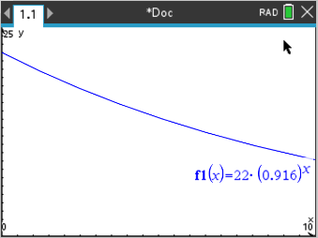
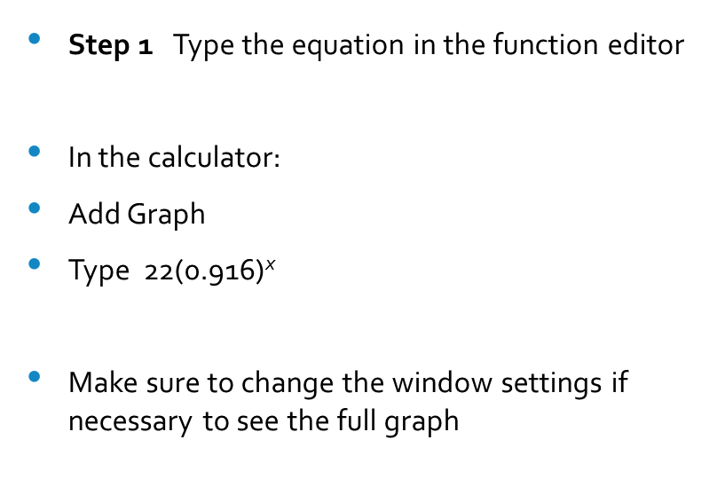
Examples
Step 1 Type the equation in the function editor
In the calculator:
Add Graph
Type $\text{ 22(0.916)}\text{x}$
Make sure to change the window settings if necessary to see the full graph

Slide 14
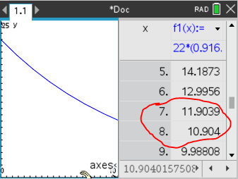
Examples
STEP 2 Create a table of function values for the death rate of Sri Lanka
In calculator:
ctrl T to get to the table
Notice that 11 deaths per 1000 will be in between 7 and 8

Slide 15
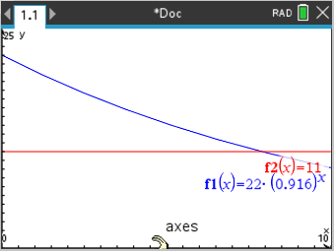
Examples
STEP 3 Since the death rate of 11 is required, make a second equation for this value
In the calculator
Ctrl T to exit the table
Tab, 11

Slide 16
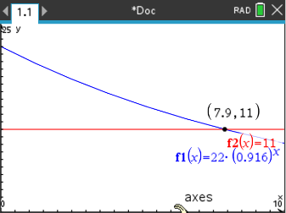
Examples
Step 4 Determine the point of intersection between the two equations
Menu, 6, 4
Get the lower and upper bounds

Slide 17
Examples
STEP 5 Interpret the intersection point in terms of the situation.
A value of x = 7.9 means that the model shows that Sri Lanka had a death rate of 11 people per 1,000 in approximately the year 1945 + 7.9 = 1952.9. Convert 0.9 years to months: 0.9(12) = 10.8 or approximately 11 months.
The equation 11 = 22(0.916)^{x} will yield the year in which Sri Lanka had a death rate of approximately 11 people per thousand. The model p(x) shows that Sri Lanka had a death rate of 11 people per thousand in November 1952.

