Slide 1
Estimating Solutions from Graphs and Tables

Slide 2
Estimating Solutions from Graphs and Tables
A graph or a table shows specific paired input and output values that satisfy a functional relationship. If you know an output value for a function, then you can use tables or graphs to determine the input value that generated the given output value.

Slide 3
Estimating Solutions from Graphs and Tables
You can use a graph or a table to approximate solutions to equations that are related to a function, f(x). If you have an equation, f(x) = b, then the following statements are true.
Graphically, locate a point on the graph of f(x) that has a y-coordinate equal to the given function value. The x-coordinate of this point is the x-value paired with that function value. This x-value is a solution to the equation. Depending on the function type, there may be zero, one, or more than one x-value that generates a particular function value.

Slide 4
Estimating Solutions from Graphs and Tables
You can use a graph or a table to approximate solutions to equations that are related to a function, f(x). If you have an equation, f(x) = b, then the following statements are true.
Tabularly, locate the function value in the dependent variable column. The value in the independent variable column corresponding with this function value is the solution to the equation. Depending on the function type, there may be zero, one, or more than one x-value that generates a particular function value.

Slide 5
In English
All this means is that we can use a table or a graph of an equation to solve for the input.
You will be doing the same things as in Lessons 47 and 48, just with different types of functions.

Slide 6
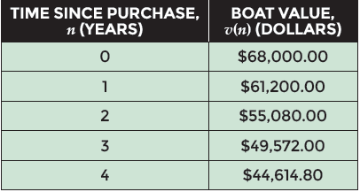
Examples
Ryan purchases a new boat for $68,000. The function v(n) = 68,000(1 – 0.1)^{n} represents the value of his boat that has an annual depreciation rate of ten percent in terms of n years since Ryan purchased the new boat. Ryan calculates the value over the first few years of ownership and records the results in a table.

Slide 7
Examples
By how much will the value of the boat will have depreciated after five years? Write an equation related to the exponential function, solve it using the table and techniques such as mental math, estimation, or number sense, and use the result to answer the question.

Slide 8
Examples
Step 1 Use the given equation to create a table
New Document
Add Graphs
Type function: 68000(1 - 0.1)^{x}
CTRL T for table
Scroll down to 5: 40,153.32

Slide 9
Examples
Step 2 Use the depreciated value to determine the amount that was depreciated
68000 – 40153.32 = 27846.68
Step 3 Interpret the answer in terms of the situation
The value of the boat will have depreciated by $27,846.68 after five years of ownership.

Slide 10
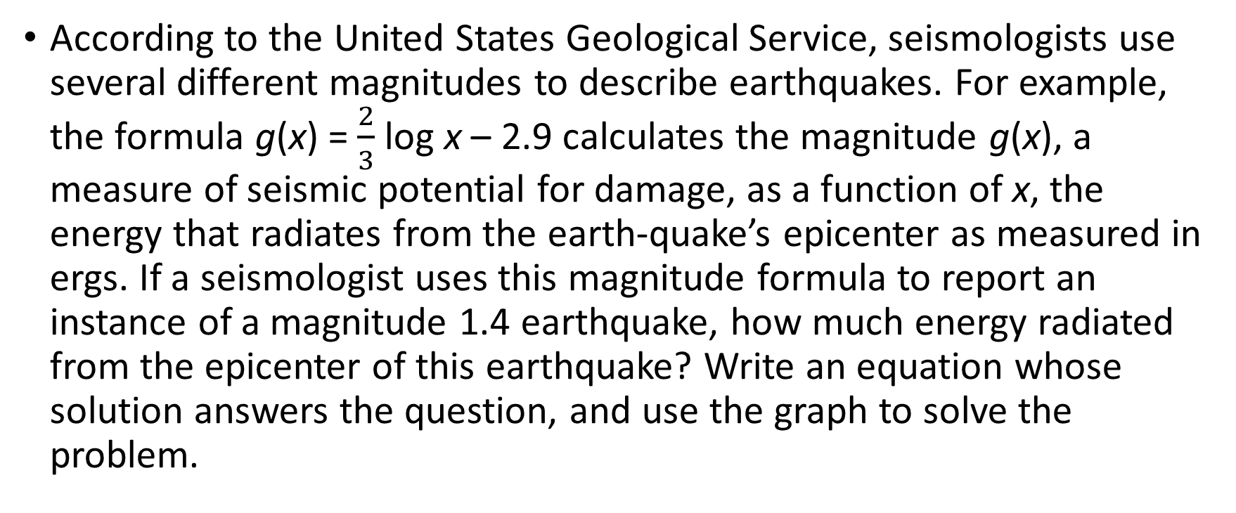
Examples
According to the United States Geological Service, seismologists use several different magnitudes to describe earthquakes. For example, the formula g(x) = $\frac{2}{3}$log x – 2.9 calculates the magnitude g(x), a measure of seismic potential for damage, as a function of x, the energy that radiates from the earth-quake’s epicenter as measured in ergs. If a seismologist uses this magnitude formula to report an instance of a magnitude 1.4 earthquake, how much energy radiated from the epicenter of this earthquake? Write an equation whose solution answers the question, and use the graph to solve the problem.

Slide 11
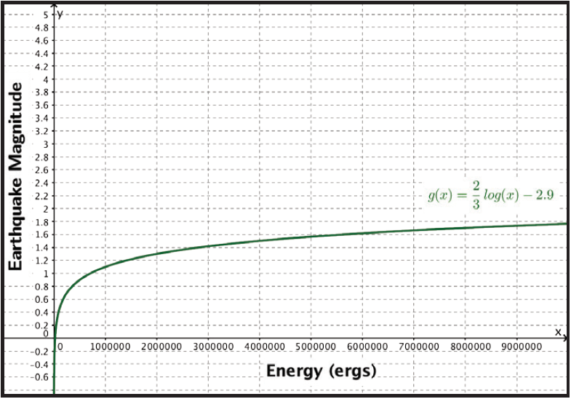
Examples

Slide 12
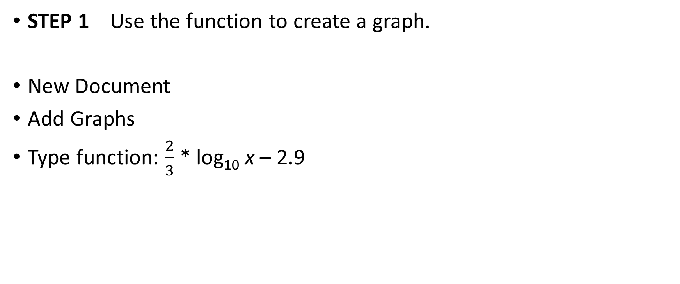
Examples
STEP 1 Use the function to create a graph.
New Document
Add Graphs
Type function: $\frac{2}{3}$* log₁₀ x – 2.9

Slide 13
Examples
Step 2 Since the magnitude of the earthquake is 1.4, make a second equation equal to 1.4 and determine the intersection
In the calculator
tab 1.4

Slide 14
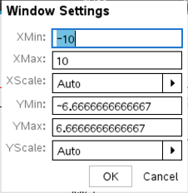
Examples
Here is where things get tricky and you have to do some work:
Menu, 4, A to show the graph doesn’t show you the whole thing so that you can find the intersection.
So we are going to change the window settings so that we can find it!
Menu, 4, 1 will open the window settings.

Slide 15
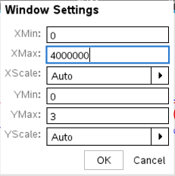
Examples
If you look at the graph that was given, it starts at 0 on the x-axis and goes to 9,000,000. However, if we look at 1.4 on the y-axis and trace across, we can see that it should intersect around 3,000,000. So let’s use this to set our window.
Notice I went just a little past where the intersection should be.

Slide 16
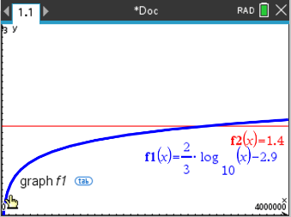
Examples
Here is the graph.
Now just find the intersection.

Slide 17
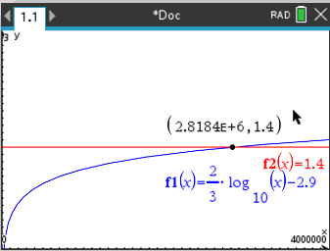
Examples
Step 3 Find the intersection
In the calculator:
Menu, 6, 4
Get the lower and upper bounds

Slide 18
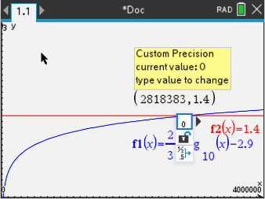
Examples
If your answer comes out in scientific notation like mine did, we can fix that too!
In the calculator:
Left click on the x-value, then right click to bring up the menu.
Select Attributes. When it asks for Custom Precision, type 0

Slide 19
Examples
Step 4 Interpret the intersection point in terms of the situation
The equation tells us that an earthquake that radiates 2,818,383 ergs of energy will have a magnitude of 1.4

