Slide 1
Solving Equations Related to Quadratic Functions

Slide 2
Quadratic Functions
Quadratic functions relate a set of input values (domain of the independent variable) to a set of output values (range of the dependent variable) using a relationship with a varying rate of change. Within the domain and range of a quadratic function, each input value generates only one output value so that the input value and its corresponding output value are paired numbers.

Slide 3
Quadratic Functions
Quadratic functions can be solved in one of 3 ways:
Graphically
Tabularly
Symbolically

Slide 4
Quadratic Functions
Graphically:
Locate the point on the graph of f(x) that has a y-coordinate equal to the given function value. The x-coordinate of this point is the x-value paired with that function value. This x-value is the solution to the equation. For a Quadratic function, there will only be one point for which this is true.

Slide 5
Quadratic Functions
Tabularly:
Locate the function value in the dependent variable column or row. The value in the independent variable column or row associated with this function value is the solution to the equation.

Slide 6
Quadratic Functions
Symbolically:
Substitute the given function value for the dependent variable in the symbolic representation of f(x). Use a method such as inverse operations, factoring and applying the zero-product property, or the quadratic formula to solve for x.

Slide 7
Examples
Several high schools in the area are having a model rocket launch. A special camera will be fixed on the top of a 20-meter tall pole to capture pictures during the rocket flights. A quadratic function can be used to represent the height above the ground, h(t), in terms of the number of seconds, t, into the flight. The Science Club has calculated the function for their rocket as h(t) = -4.9t2 + 20t + 1.5 when the launch pad is 1.5 meters above the ground. A related equation, y = 20, represents the height of the camera’s aim. Graph the function and equation, then determine when the camera will capture a picture of their rocket.

Slide 8
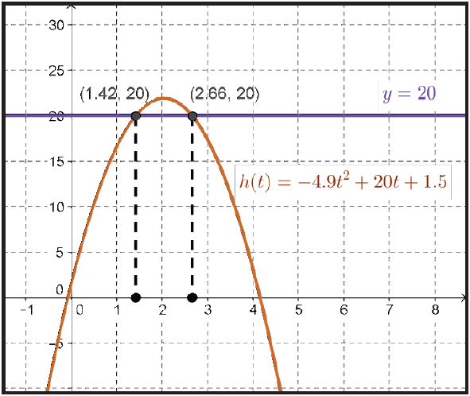
Examples
STEP 1 Graph the function h(t) = –4.9t² + 20t + 1.5 and the related equation y = 20.

Slide 9
Examples
STEP 2 Determine the points on the graph of h(t) with a y-coordinate or height of 20 meters.
The intersection of the graph of h(t) and the line y = 20 will show two such points since h(x) is a quadratic function, unless 20 meters is the highest point of the flight or taller than the highest point of the flight. The points (1.42, 20) and (2.66, 20) both have a y-coordinate of 20.

Slide 10
Examples
STEP 3 Interpret the points of intersection of the graphs.
If all goes as planned, the camera will capture pictures of the Science Club’s rocket at 1.42 and 2.66 seconds after the launch.

Slide 11
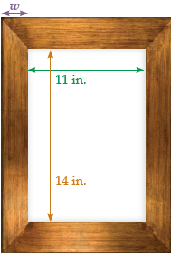
Examples
The standard framing for an 11-inch by 14-inch picture with a frame w inches wide produces a total area A(w). The total area, measured in square inches, varies according to the width of the frame. How wide should the frame be for a framed picture with a total area of about 400 square inches?

Slide 12
Examples
STEP 1 Write a function for the total area, A(w), in terms of w, the width of the frame.
The width of the framed picture is 11 + 2w. The length is 14 + 2w. The total area is
A(w) = (11 + 2w)(14 + 2w)
A(w) = 154 + 22w + 28w + 4w²
A(w) = 4w² + 50w + 154.

Slide 13

Examples
STEP 2 Create a table of function values for the total area.

Slide 14
Examples
STEP 3 Write a related equation for the total area of 400 square inches.
400 = 4w² + 50w + 154

Slide 15
Examples
STEP 4 Use the table to determine the necessary width for this value of A(w).
The total area of 418 square inches is produced when the frame is 4 inches wide. To find a total area closer to 400 square inches evaluate the function for a narrower width, such as 3.75 inches.
4(3.75)2 + 50(3.75) + 154 = 397.75 square inches
So the frame width of 3.75 inches will produce a total framed picture area of almost 400 square inches.

Slide 16
Examples
Mrs. Samuels want to build a store with an area of 2,000 square feet on a lot measuring 60 feet by 70 feet. She finds out that the city code restricts building any closer than 10 feet from the lot lines. Can her store have an area of 2,000 square feet and stay within legal limits?

Slide 17
Examples
STEP 1 Write a function to model the building area, A(x), in terms of the distance, x, to the lot lines.
The area of the lot is 60 times 70, or 4,200 square feet. The building can be no wider than 60 – 2x and no longer than 70 – 2x. The area of the building should be A(x) = (l)(w) = (70 – 2x)(60 – 2x).

Slide 18
Examples
STEP 2 Simplify the function rule.
A(x) = (70 – 2x)(60 – 2x)
A(x) = 70(60 – 2x) – 2x(60 – 2x)
A(x) = 4200 – 140x – 120x + 4x²
A(x) = 4x² – 260x + 4200

Slide 19
Examples
STEP 3 Write a related equation with Mrs. Samuels’ building area of 2,000 square feet.
2000 = 4x² – 260x + 4200

Slide 20
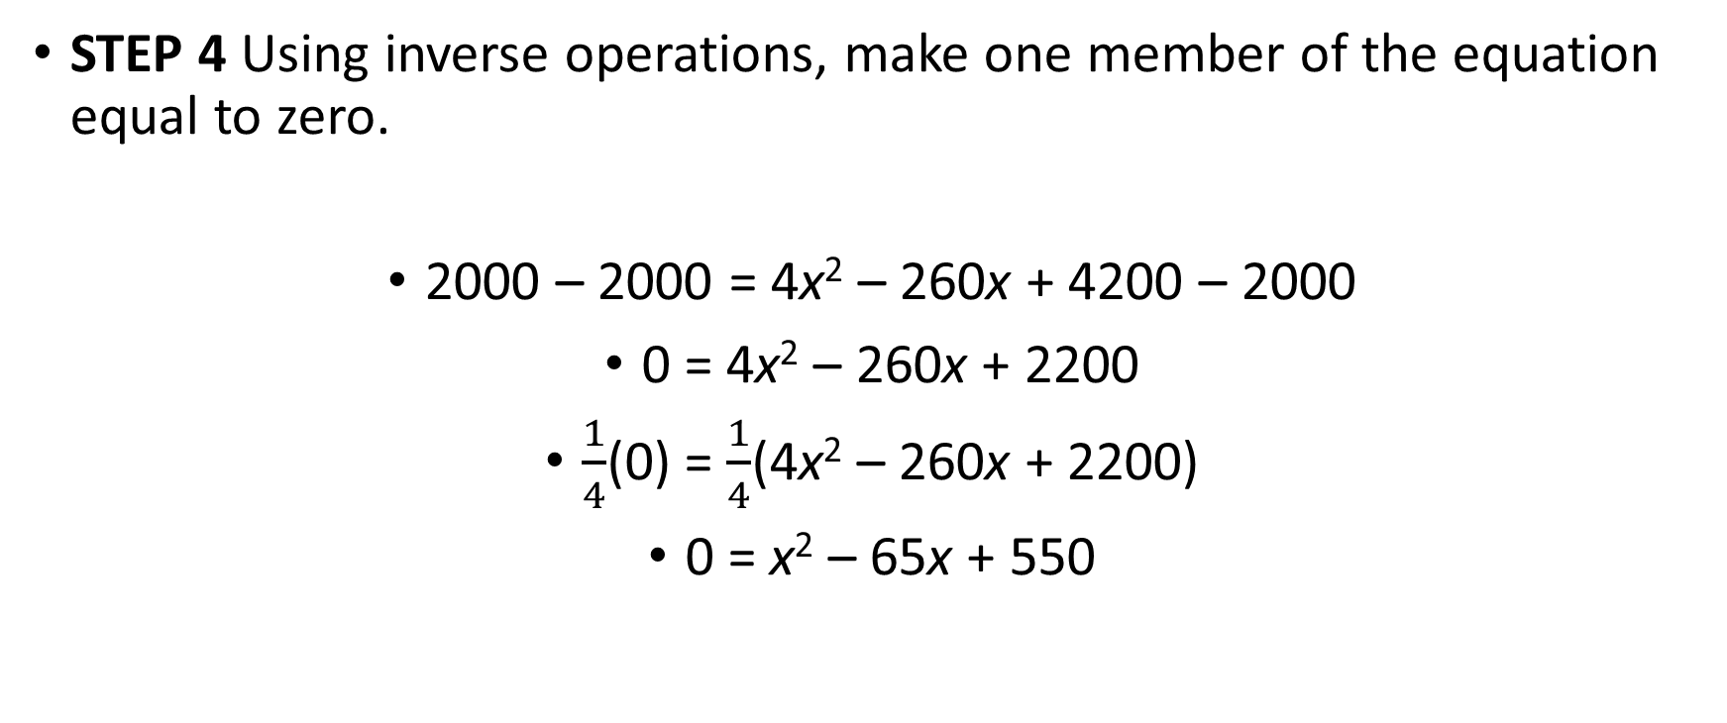
Examples
STEP 4 Using inverse operations, make one member of the equation equal to zero.
2000 – 2000 = 4x² – 260x + 4200 – 2000
0 = 4x² – 260x + 2200
$\frac{1}{4}$(0) = $\frac{1}{4}$(4x² – 260x + 2200)
0 = x² – 65x + 550

Slide 21
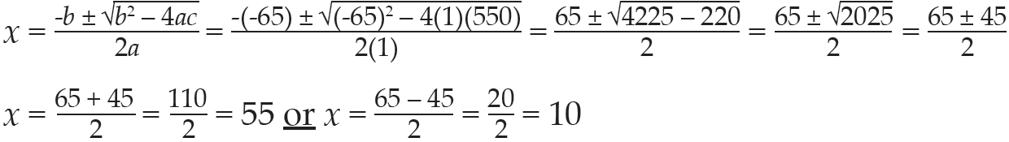
Examples
STEP 5 Since this is a quadratic polynomial equation equal to zero, you can use the quadratic formula to solve for x. In this case, a = 1, b = –65, and c = 550.

Slide 22
Examples
STEP 6 As this is a quadratic function, there are two solutions, x = 55 or x = 10. The distance, x, from the lot lines can be no less than 10 feet. The first solution does not make sense in this problem because a building cannot be 55 feet from all sides of the 60- feet by 70-feet lot.
However, the second solution of 10 generates a building with the dimensions shown.
length = 70 – 2x width = 60 – 2x
length = 70 – 2(10) width = 60 – 2(10)
length = 50 feet width = 40 feet
The building will have an area of 2,000 square feet and remain within the city code.

