Slide 1
Solving Equations Related to Linear Functions

Slide 2
Linear Functions
Linear functions relate a set of input values (domain of the independent variable) to a set of output values (range of the dependent variable) using a relationship with a constant rate of change.
Within the domain and range of a linear function, each input value generates only one output value so that the input value and its corresponding output value are paired numbers.

Slide 3
Linear Functions
Linear functions can be solved in one of 3 ways:
Graphically
Tabularly
Symbolically

Slide 4
Linear Functions
Graphically:
Locate the point on the graph of f(x) that has a y-coordinate equal to the given function value. The x-coordinate of this point is the x-value paired with that function value. This x-value is the solution to the equation. For a linear function, there will only be one point for which this is true.

Slide 5
Linear Functions
Tabularly:
Locate the function value in the dependent variable column or row. The value in the independent variable column or row associated with this function value is the solution to the equation. For a linear function, there will only be one point for which this is true.

Slide 6
Linear Functions
Symbolically:
Substitute the given function value for the dependent variable in the symbolic representation of f(x). Use inverse operations to solve the equation for the independent variable, x.

Slide 7
Examples
Isabel is saving money for a used car. So far, she has $700 in her savings account. She plans to deposit $15 each week from her part-time job and her grandparents give her $50 on her birthday each year. The goal is to earn $3,000 by the time she graduates from high school. Will she be able to meet that goal in three years?

Slide 8
Examples
STEP 1 Write a function that models Isabel’s savings.
If x represents the number of years, then her savings will be the combination of the $700 she already has, her savings of $15 per week times 52 weeks per year, and an additional $50 per year from her grandparents. So s(x) = 700 + 15(52)x + 50x.

Slide 9
Examples
STEP 2 Simplify the function s(x) = 700 + 15(52)x + 50x.
s(x) = 700 + 15(52)x + 50x
s(x) = 700 + 780x + 50x
s(x) = 700 + 830x
s(x) = 830x + 700
Note: You don’t have to simplify the function, the calculator will do it for you! Just make sure that you have the correct function!

Slide 10
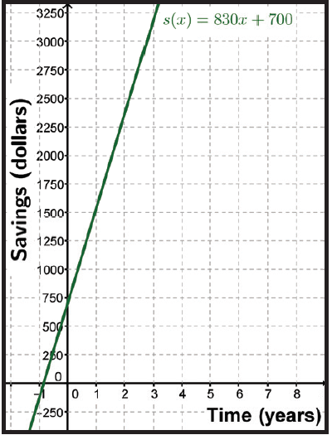
Examples
STEP 3 Using the function s(x) = 830x + 700, make a graph of Isabel’s savings.

Slide 11
Examples
STEP 4 Write an equation for the amount of savings, $3000, which Isabel has for a savings goal.
y = $3000

Slide 12
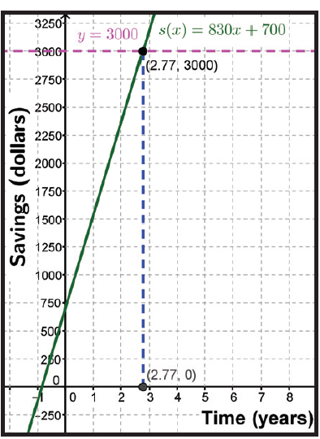
Examples
STEP 5 Graph both equations on the same grid to determine when Isabel will have $3,000 in savings.
The line of y = 3000 intersects the graph of the function s(x) = 830x + 700 at 2.77 years. Isabel will indeed meet her goal in slightly less than 3 years.

Slide 13
Examples
Lia won $45,500 for her prize steer at the state fair. She is going to use the money to buy a used car for $3,700 and to go to a state university away from home. Her yearly expenses will be $4,800 for tuition and books and $5,800 for room and board. Lia estimates that she will spend another $3,000 for gasoline, insurance, and incidentals each year. Will her prize money last throughout the 4 years of college? Write a function, f(x), to represent how much money Lia will have left after each year, x, and make a table of function values. Then write a related equation with the output value of zero to find out when she will be out of money and solve the problem tabularly.

Slide 14
Examples
STEP 1 Write a function to represent the money Lia will have left after each year of college.
The function shows an amount of money, $45,500 less the one-time expenditure of $3,700 for a car. She has yearly expenditures of $4,800 for tuition and books, $5,800 for room and board, and $3,000 for personal expenses.
f(x) = 45,500 – 3,700 – (4,800 + 5,800 + 3,000)x
f(x) = 41,800 – 13,600x (after buying the car and combining yearly expenditures.)

Slide 15
Examples
STEP 2 Create a table with the values for the function.

Slide 16
Examples
STEP 3 Write an equation for the amount of money Lia expects to have at the end of her 4th year.
y = 41,800 – 13,600x

Slide 17
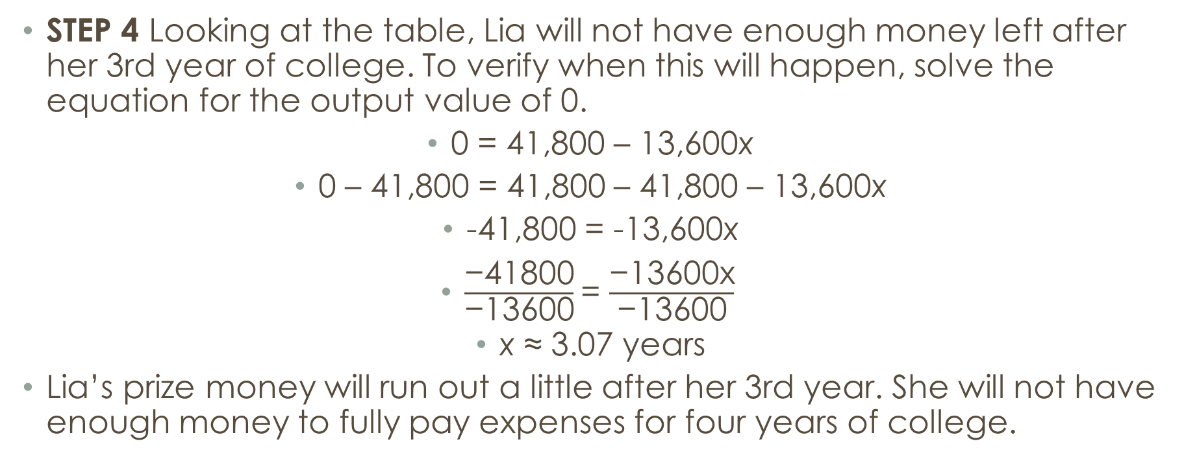
Examples
STEP 4 Looking at the table, Lia will not have enough money left after her 3rd year of college. To verify when this will happen, solve the equation for the output value of 0.
0 = 41,800 – 13,600x
0 – 41,800 = 41,800 – 41,800 – 13,600x
-41,800 = -13,600x
$\frac{\text{−41800}}{\text{−13600}}$= $\frac{\text{−13600}\text{x}}{\text{−13600}}$
x ≈ 3.07 years
Lia’s prize money will run out a little after her 3rd year. She will not have enough money to fully pay expenses for four years of college.

Slide 18
Examples (Calculator)
Lia won $45,500 for her prize steer at the state fair. She is going to use the money to buy a used car for $3,700 and to go to a state university away from home. Her yearly expenses will be $4,800 for tuition and books and $5,800 for room and board. Lia estimates that she will spend another $3,000 for gasoline, insurance, and incidentals each year. Will her prize money last throughout the 4 years of college? Write a function, f(x), to represent how much money Lia will have left after each year, x, and make a table of function values. Then write a related equation with the output value of zero to find out when she will be out of money and solve the problem tabularly.

Slide 19
Examples
A science museum offers specially priced tickets for group tours. Each student admission is $6.50. An adult sponsor is required for every ten students, and an adult admission is $8.50. A $25 booking fee is added to the cost. If there is a budget of $500 for the tour, how many students will be able to go to the museum? Write a function, t(x), representing the total cost for x students, and a related equation for the total cost of $500. Solve the equation to determine the number of students who can go.

Slide 20
Examples
STEP 1 Write a function representing the total cost for x students.
t(x) = 6.50x + 8.50(x – 10) + 25 = 6.50x + 0.85x + 25
t(x) = 7.35x + 25.

Slide 21
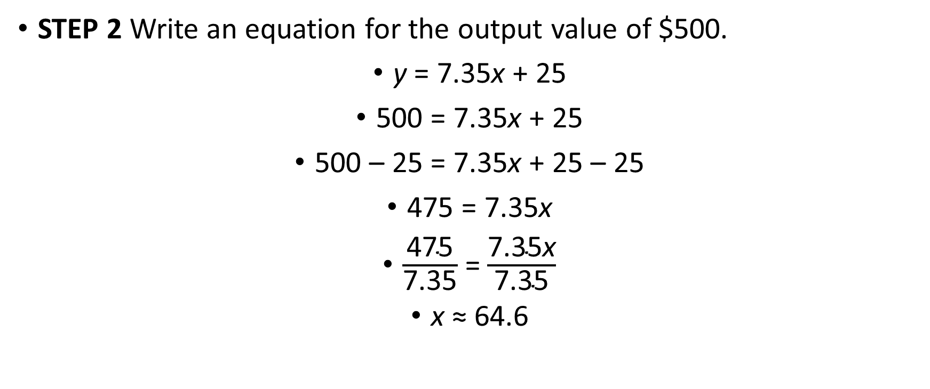
Examples
STEP 2 Write an equation for the output value of $500.
y = 7.35x + 25
500 = 7.35x + 25
500 – 25 = 7.35x + 25 – 25
475 = 7.35x
$\frac{\text{475}}{\text{7.35}}$= $\frac{\text{7.35}\text{x}}{\text{7.35}}$
x ≈ 64.6

Slide 22
Examples
STEP 3 Interpret the results of solving the equation.
Since x equals approximately 64.6 students, only 64 students can go on the tour since 65 students would put them over budget.

