Slide 1
Solving Equations Related to Linear Functions
Calculator procedure

Slide 2
Examples
Isabel is saving money for a used car. So far, she has $700 in her savings account. She plans to deposit $15 each week from her part-time job and her grandparents give her $50 on her birthday each year. The goal is to earn $3,000 by the time she graduates from high school. Will she be able to meet that goal in three years?

Slide 3
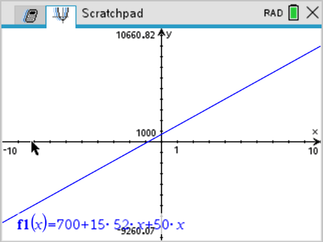
Examples
STEP 1 Write a function that models Isabel’s savings.
s(x) = 700 + 15(52)x + 50x.
In the calculator:
Add graph
Type in function
MENU, 4, A → fits graph so you can see it

Slide 4
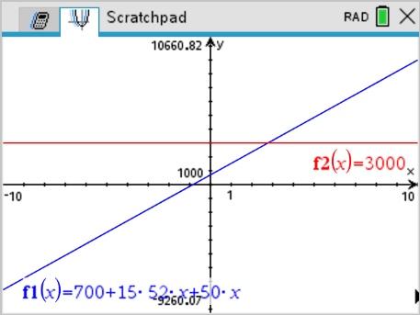
Examples
STEP 2 Write an equation for the amount of savings, $3000, which Isabel has for a savings goal.
y = $3000
In the calculator:
Tab → this takes you back to the function editor
Type 3000

Slide 5
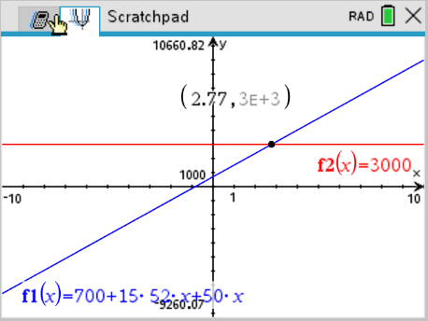
Examples
STEP 3 Find the intersection
In the calculator:
Type Menu, 6, 4
Lower bound: place cursor to left of intersection
Upper bound: place cursor to right of intersection
You will now get the intersection

Slide 6
Examples
The x-value for the ordered pair gives how long it will take to earn the money for the car, which is less than 3 years.

Slide 7
Examples
Lia won $45,500 for her prize steer at the state fair. She is going to use the money to buy a used car for $3,700 and to go to a state university away from home. Her yearly expenses will be $4,800 for tuition and books and $5,800 for room and board. Lia estimates that she will spend another $3,000 for gasoline, insurance, and incidentals each year. Will her prize money last throughout the 4 years of college? Write a function, f(x), to represent how much money Lia will have left after each year, x, and make a table of function values. Then write a related equation with the output value of zero to find out when she will be out of money and solve the problem tabularly.

Slide 8
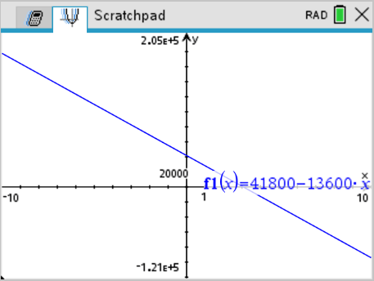
Examples
STEP 1 Write a function to represent the money Lia will have left after each year of college.
f(x) = 41,800 – 13,600x
In the calculator:
Add graph
Type in function
MENU, 4, A → fits graph so you can see it

Slide 9
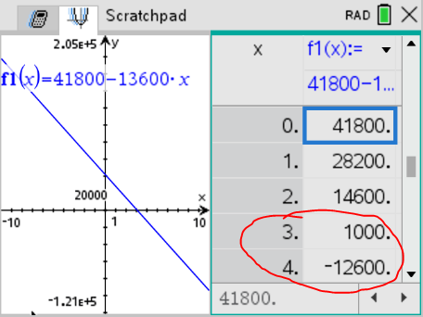
Examples
Step 2 Create a table with the values for the function.
In the calculator:
ctrl T to get to the table
“Will her prize money last throughout the 4 years of college?”
Look at the table. Between 3 and 4, the numbers go from positive to negative. This means she runs out of money before 4.

Slide 10
Examples
Since she runs out of money before the 4 years, then her prize money will not last throughout the 4 years of college

