Slide 1
Solving Systems of Three
Linear Equations

Slide 2
Systems of Linear Equations
Situations with three unknowns require particular pieces of information in order to solve for the values of those unknowns. To write a system of equations for the situation, you need to have as many equations as you do unknowns in order to solve the system. If the equations are all linear equations, then you can use matrices to solve the system of three linear equations.

Slide 3
Systems of Linear Equations
For a system of three linear equations with three unknowns, you can use a matrix equation with 3 × 4 matrices to represent the system. This process is similar to what you did with systems of two linear equations with two unknowns.
Make sure that all linear equations are in standard form, Ax + By + Cz = D. If one variable is missing from the equation, be sure to use a term with 0 as the coefficient as a placeholder.

Slide 4

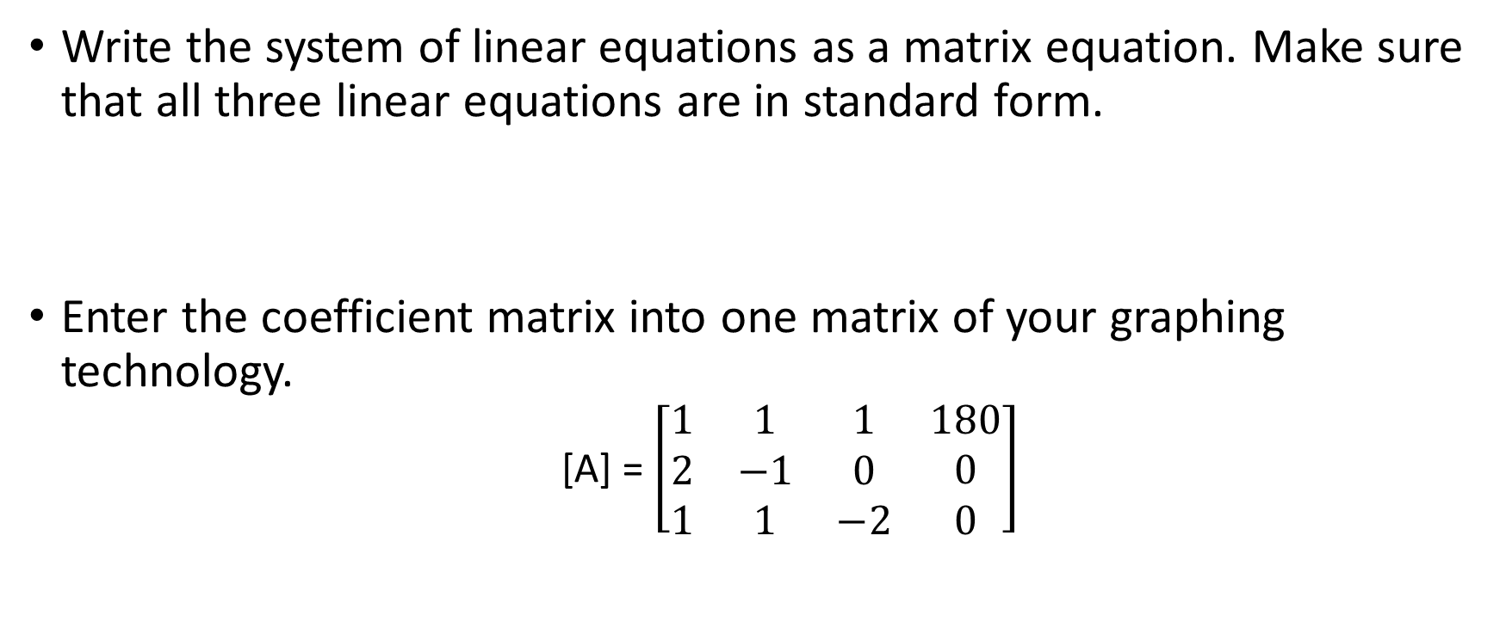
Systems of Linear Equations
Write the system of linear equations as a matrix equation. Make sure that all three linear equations are in standard form.
Enter the coefficient matrix into one matrix of your graphing technology.
  [A] = $\left[\begin{matrix}1 & 1 & 1 \\ 2 & −1 & 0 \\ 1 & 1 & −2\end{matrix} \begin{matrix}180 \\ 0 \\ 0\end{matrix}\right]$

Slide 5
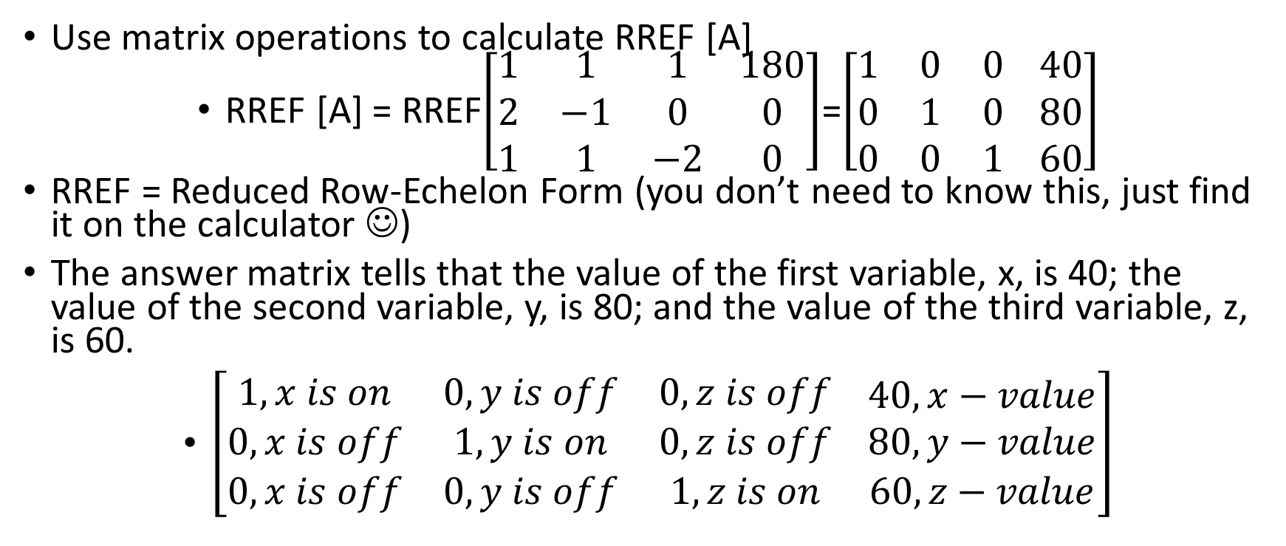
Systems of Linear Equations
Use matrix operations to calculate RREF [A]
RREF [A] = RREF$\left[\begin{matrix}1 & 1 & 1 \\ 2 & −1 & 0 \\ 1 & 1 & −2\end{matrix} \begin{matrix}180 \\ 0 \\ 0\end{matrix}\right]$=$\left[\begin{matrix}1 & 0 & 0 \\ 0 & 1 & 0 \\ 0 & 0 & 1\end{matrix} \begin{matrix}40 \\ 80 \\ 60\end{matrix}\right]$
RREF = Reduced Row-Echelon Form (you don’t need to know this, just find it on the calculator ☺)
The answer matrix tells that the value of the first variable, x, is 40; the value of the second variable, y, is 80; and the value of the third variable, z, is 60.
$\left[\begin{matrix}1, x is on & 0, y is off & 0, z is off \\ 0, x is off & 1, y is on & 0, z is off \\ 0, x is off & 0, y is off & 1, z is on\end{matrix} \begin{matrix}40,x−value \\ 80,y−value \\ 60,z−value\end{matrix}\right]$

Slide 6
Examples
Points X and Y are between points W and Z. The distance between points W and Z is thirty-six millimeters. The distance between points W and X is half the distance from point X to point Y. The distance between points Y and Z is one millimeter less than the distance from point X to point Y. What is the length in millimeters of each segment? Write a system of three linear equations to represent the situation and a matrix equation to represent the system. Represent and solve the system using matrices with technology.

Slide 7
Examples
STEP 1 Define variables to represent the unknowns and use them write a system of linear equations to represent the system.
Since the problem asks you to determine the length of the segments, the variables will represent the lengths, in millimeters, of the three segments. Let x represent the length of WX, let y represent the length of XY, and let z represent the length of YZ.

Slide 8
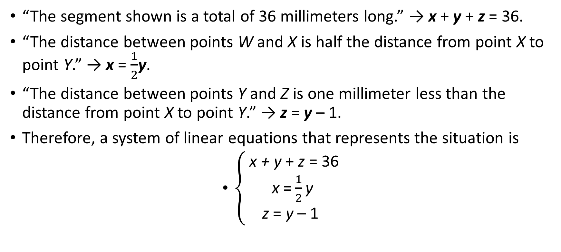
Examples
“The segment shown is a total of 36 millimeters long.” → x + y + z = 36.
“The distance between points W and X is half the distance from point X to point Y.” → x = $\frac{1}{2}$y.
“The distance between points Y and Z is one millimeter less than the distance from point X to point Y.” → z = y – 1.
Therefore, a system of linear equations that represents the situation is
$\left\{\begin{aligned} \text{x}\text{ + }\text{y} \text{+ }\text{z} \text{= 36 } \\ \text{x} \text{=}\frac{1}{2}\text{y} \\ \text{z} \text{= }\text{y} \text{– 1 }\end{aligned}\right.$

Slide 9
Examples
STEP 2 Write a matrix equation that corresponds to the system of linear equations you wrote in Step 1. If necessary, rewrite any linear equations that are not already in standard form before writing the matrix equation.
Two of the linear equations in the system you wrote in Step 1 are not in standard form, so it is necessary to rewrite both equations. Remember that if an equation does not contain all three variables, you should use a term with 0 as a coefficient as a placeholder.

Slide 10
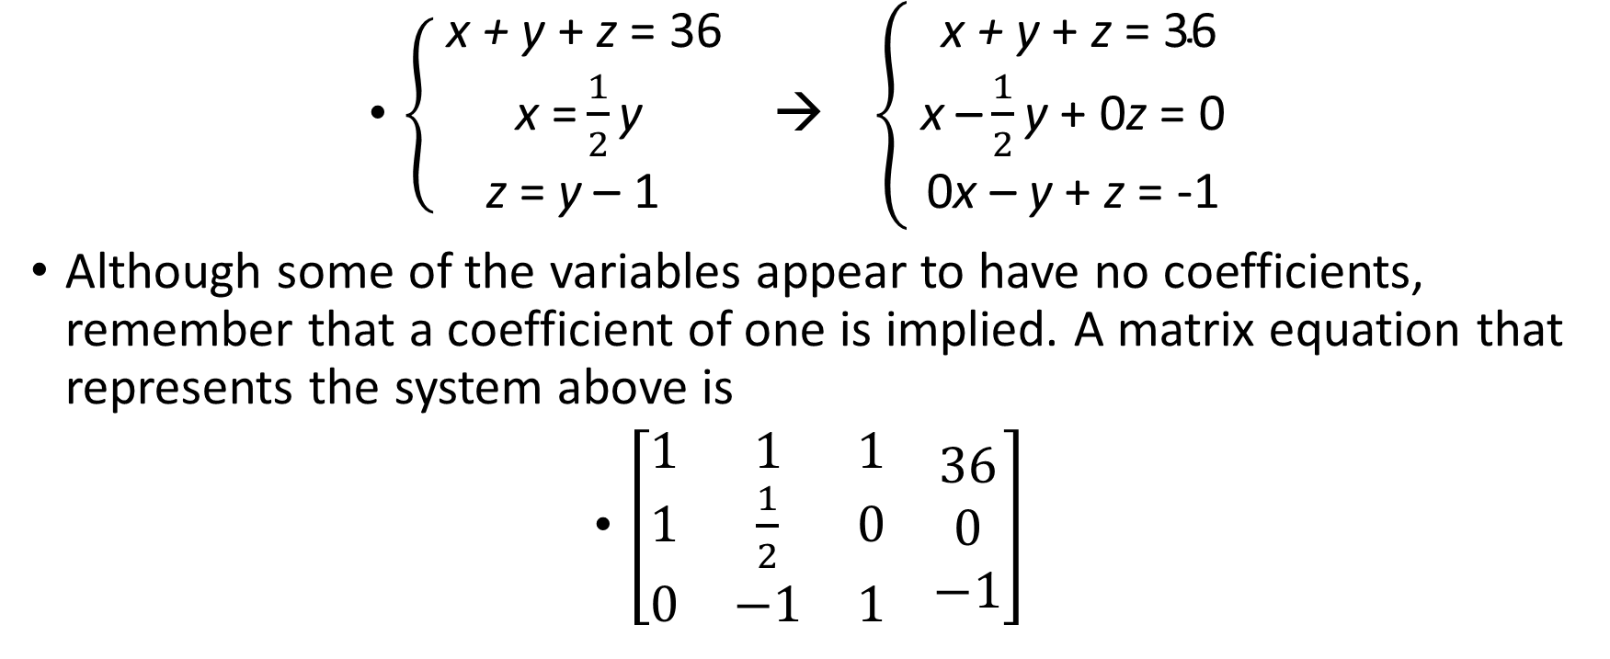
Examples
$\left\{\begin{aligned} \text{x}\text{ + }\text{y} \text{+ }\text{z} \text{= 36 } \\ \text{x} \text{=}\frac{1}{2}\text{y} \\ \text{z} \text{= }\text{y} \text{– 1 }\end{aligned} \right.$ → $\left\{\begin{aligned} \text{x}\text{ + }\text{y} \text{+ }\text{z} \text{= 36 } \\ \text{x} \text{–}\frac{1}{2}\text{y} \text{+ 0}\text{z} \text{= 0 } \\ \text{ 0}\text{x} \text{– }\text{y} \text{+ }\text{z} \text{= -1 }\end{aligned}\right.$
Although some of the variables appear to have no coefficients, remember that a coefficient of one is implied. A matrix equation that represents the system above is
$\left[\begin{matrix}1 & 1 & 1 \\ 1 & \frac{1}{2} & 0 \\ 0 & −1 & 1\end{matrix} \begin{matrix}36 \\ 0 \\ −1\end{matrix}\right]$

Slide 11
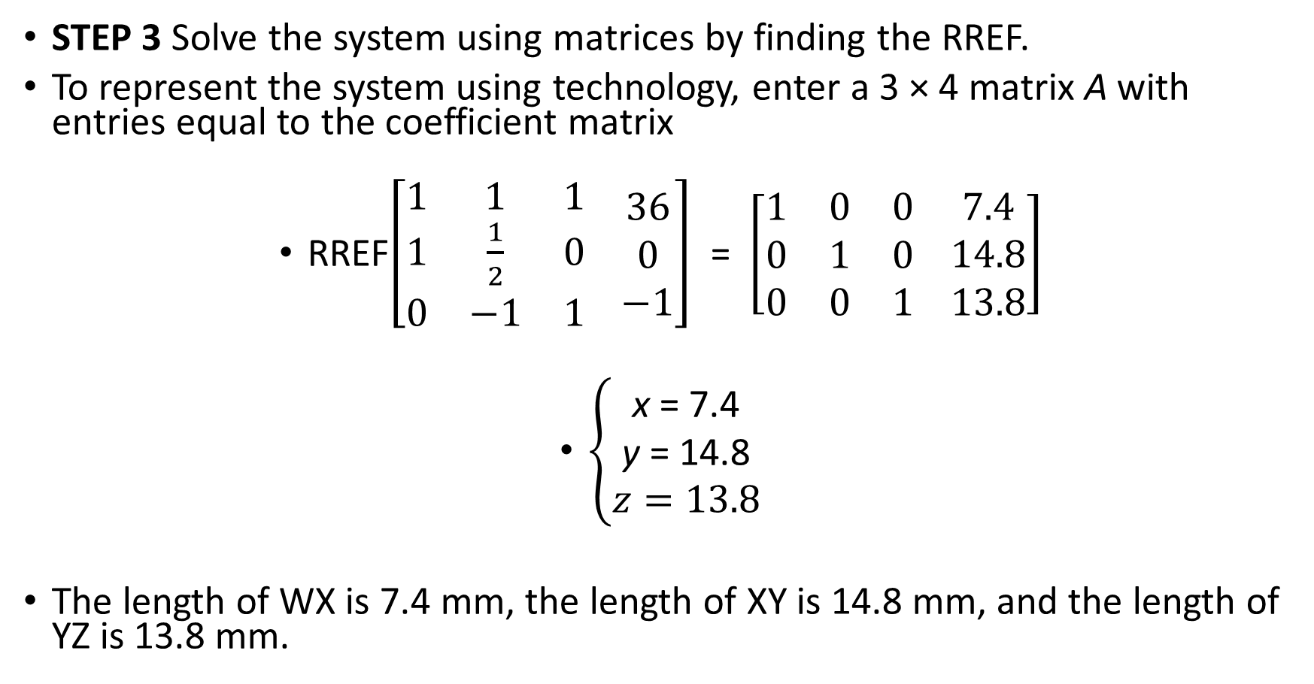
Examples
STEP 3 Solve the system using matrices by finding the RREF.
To represent the system using technology, enter a 3 × 4 matrix A with entries equal to the coefficient matrix
RREF$\left[\begin{matrix}1 & 1 & 1 \\ 1 & \frac{1}{2} & 0 \\ 0 & −1 & 1\end{matrix} \begin{matrix}36 \\ 0 \\ −1\end{matrix}\right]$ = $\left[\begin{matrix}1 & 0 & 0 \\ 0 & 1 & 0 \\ 0 & 0 & 1\end{matrix} \begin{matrix}7.4 \\ 14.8 \\ 13.8\end{matrix}\right]$
$\left\{\begin{aligned}\text{x} \text{= }\text{7.4} \\ \text{y} \text{= }\text{14.8} \\ z=13.8\end{aligned}\right.$
The length of WX is 7.4 mm, the length of XY is 14.8 mm, and the length of YZ is 13.8 mm.

