Slide 1
Dividing Polynomial Functions Using Tables

Slide 2
Dividing Polynomial Functions
Functions can be divided using tables of function values.
For a set of x-values, determine the function values that represent the dividend and the function values that represent the divisor.
Divide each set of function values.
Use finite differences to determine what type of function the quotient is and represent the quotient function symbolically.

Slide 3
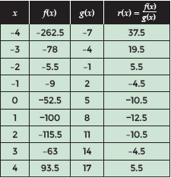
Examples
Given the functions f(x) = 6x³ – 2x² – 51.5x – 52.5 and g(x) = 3x + 5 and the ratio r(x) = $\frac{f(x)}{g(x)}$, determine what type of functions the divisor and dividend are and use the table of values to write a symbolic representation of the ratio.

Slide 4
Examples
STEP 1 The dividend for the ratio, r(x), is the function f(x) = 6x³ – 2x² – 51.5x – 52.5, and the divisor is the function g(x) = 3x + 5. Determine the type of functions f(x) and g(x) are and predict the type of function that best represents the ratio r(x).
f(x) has a degree of 3 which makes it a cubic function
g(x) has a degree of 1 which makes it a linear function
r(x) should be a quadratic function with a degree of 2

Slide 5
Examples
STEP 2 Find the finite differences in the table values for r(x).
As predicted, the second finite differences are constant and r(x) is a quadratic function of degree two.

Slide 6
Examples
STEP 3 Use the patterns found in the table and the finite differences to determine a function rule.
The function rule for the ratio is the quadratic polynomial r(x) = 2x² – 4x – 10.5

Slide 7
Examples

Slide 8
Examples

Slide 9
Examples

Slide 10
Examples

