Slide 1
Decomposing Polynomial Functions

Slide 2
Decomposing Polynomial Functions
Decomposing a polynomial function means to write it as a product of factors. Zeroes of the function can be used to identify linear factors of the polynomial function.
In a graph, zeroes of a polynomial function can be identified from the x-coordinates of the x-intercepts.
In a table, zeroes of a polynomial function can be identified by an x-value that generates a function value of 0.

Slide 3
Examples
Given the table of values, write a cubic function, f(x), as a product of linear factors. Graph the function to verify.

Slide 4
Examples
STEP 1 The table of values shows three zeroes for f(x). The function values are zero when x is –2, 0, and 5. Using that information, write the three factors of f(x).
x = -2 x = 0 x = 5
x + 2 = 0 x – 5 = 0
STEP 2 Write the function f(x) in factored form.
f(x) = x(x + 2)(x – 5)

Slide 5
Examples
STEP 3 Graph the function. Verify that the zeroes in the graph are the same as x-coordinates for the function values of zero in the table.

Slide 6
Examples
Given the graph, write a quadratic function g(x) as a product of linear factors. Graph the function you have written and compare it to the given graph. What factor may be missing from your written function?

Slide 7
Examples
STEP 1 Use the zeroes in the graph to write the linear factors of the function.
(–0.5, 0) → zero: -$\frac{1}{2}$; factor: (2x + 1)
(2, 0) → zero: 2; factor: (x – 2)
STEP 2 Write the function as a product of its linear factors and as a polynomial.
g(x) = (2x + 1)(x – 2) = 2x² – 4x + 1x – 2 = 2x² – 3x – 2

Slide 8
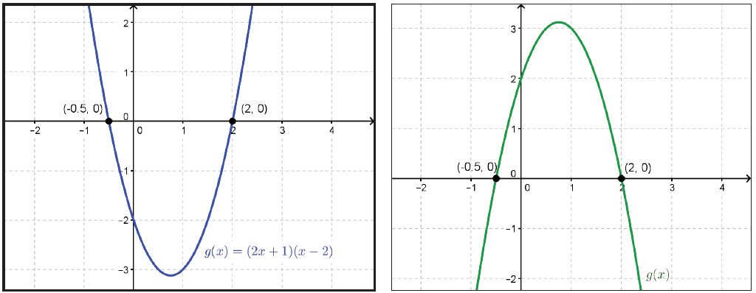
Examples
STEP 3 Graph the written function and compare it to the given graph.

Slide 9
Examples
This graph has the same x-intercepts or zeroes, but it is a reflection of the given graph (in green) over the x-axis. This means that a factor of -1 is missing in the written function. Apply this factor to write the function that matches the given graph.
g(x) = -1(2x + 1)(x – 2) or -1(2x² – 3x – 2) = -2x² + 3x + 2

