Slide 1
Factoring Polynomials With Graphs and Tables

Slide 2

Factoring Polynomials
Factoring a polynomial is a method of rewriting a polynomial as a set of factors that can be multiplied together in order to generate the original polynomial.
Writing a polynomial in factored form allows you to do several things, including divide polynomials, simplify rational or polynomial expressions, and look for solutions to polynomial equations.

Slide 3
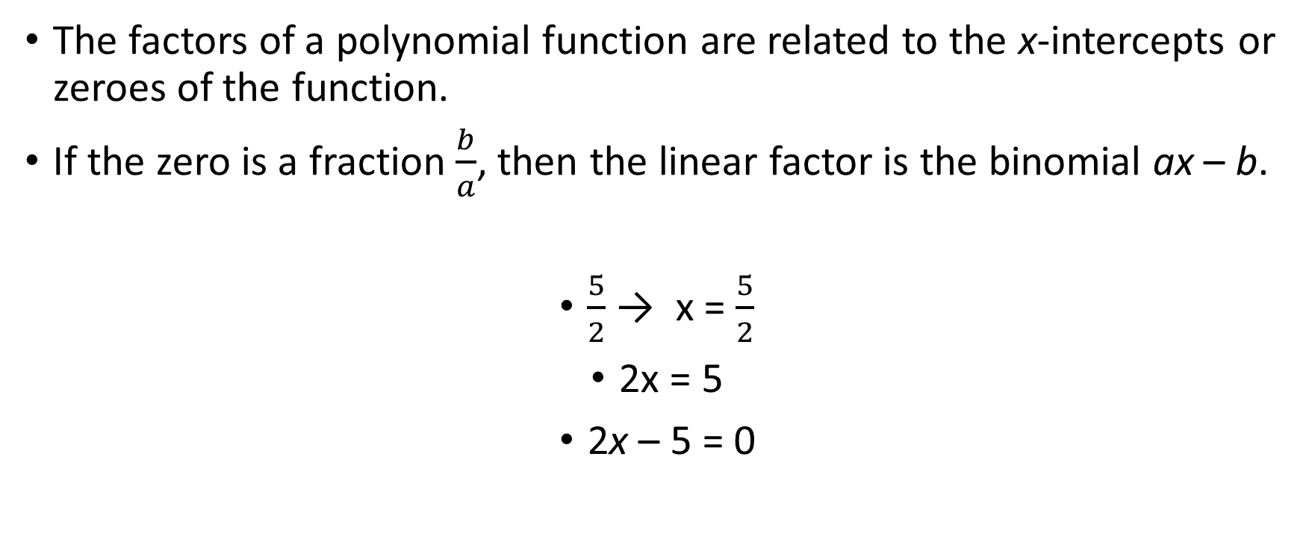
Factoring Polynomials
The factors of a polynomial function are related to the x-intercepts or zeroes of the function.
If the zero is a fraction $\frac{b}{a}$, then the linear factor is the binomial ax – b.
$\frac{5}{2}$ → x = $\frac{5}{2}$
2x = 5
2x – 5 = 0

Slide 4
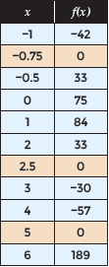
Factoring Polynomials
You can also use a table of values to identify the zeros (x-intercepts) of a function. The table shows a set of function values for f(x) = 8x³ – 54x² + 55x + 75.
The zeros of f(x) are the x-values where f(x) = 0. In the table, there are three x-values where f(x) = 0: x = −0.75, 2.5, and 5.
Once the zeros have been identified, write any non-integer zeros as fractions and use the fraction to write a linear factor.

Slide 5
Factoring Polynomials
There is also a relationship between the degree of a polynomial and the number of factors you can expect.
A linear function is a polynomial function of degree one. A linear function has up to one x-intercept, but it may have no x-intercepts.
A quadratic function is a polynomial function of degree two. A quadratic function has up to two x-intercepts, but it may have only one x-intercept or no x-intercepts.
A cubic function is a polynomial function of degree three. A cubic function has up to three x-intercepts, but it may have fewer than three x-intercepts.

Slide 6
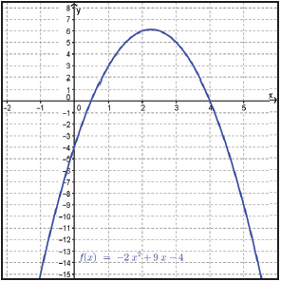
Examples
Factor the quadratic function f(x) = -2x² + 9x – 4 using a graph.

Slide 7
Examples
STEP 1 Determine the x-intercepts of the quadratic function from its graph. Verify your answers by using the equation of the function.
x = ½ and 4
STEP 2 Use each x-intercept to determine binomial factors.
x = ½ x = 4
2x = 1 x – 4 = 0
2x – 1 = 0

Slide 8
Examples
STEP 3 Multiply the binomial factors and compare to the symbolic representation of f(x).
Use the function builder in the calculator to check against the original function.
STEP 4 Write the function as a product of its binomial factors. Since the parabola opens downward, multiply by −1.
-f(x) = (2x – 1)(x – 4)
(-1)(-f(x)) = (-1)(2x – 1)(x – 4)
f(x) = -(2x – 1)(x – 4)

Slide 9
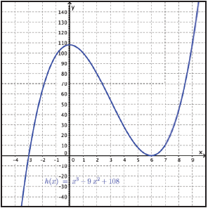
Examples
Factor the cubic function h(x) = x³ – 9x² + 108 using a graph.

Slide 10
Examples
STEP 1 Determine the x-intercepts of the cubic function from its graph. Verify your answers by using the equation of the function.
x = -3 and 6
STEP 2 Use each x-intercept to determine binomial factor(s).
x = -3 x = 6
x + 3 = 0 x – 6 = 0
The binomial factors of h(x) are (x + 3) and (x – 6).
Because the graph touches the x-axis at 6 rather than crossing it, the binomial factor (x – 6) is repeated.

Slide 11
Examples
STEP 3 Multiply the binomial factors and compare to the symbolic representation of h(x).
Use the function builder in the calculator to check against the original function.
STEP 4 Write the function as a product of its binomial factors.
h(x) = (x + 3)(x – 6)(x – 6)
h(x) = (x + 3)(x – 6)²

Slide 12
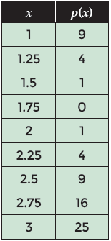
Examples
Factor the quadratic function p(x) = 16x² – 56x + 49 using a table.

Slide 13
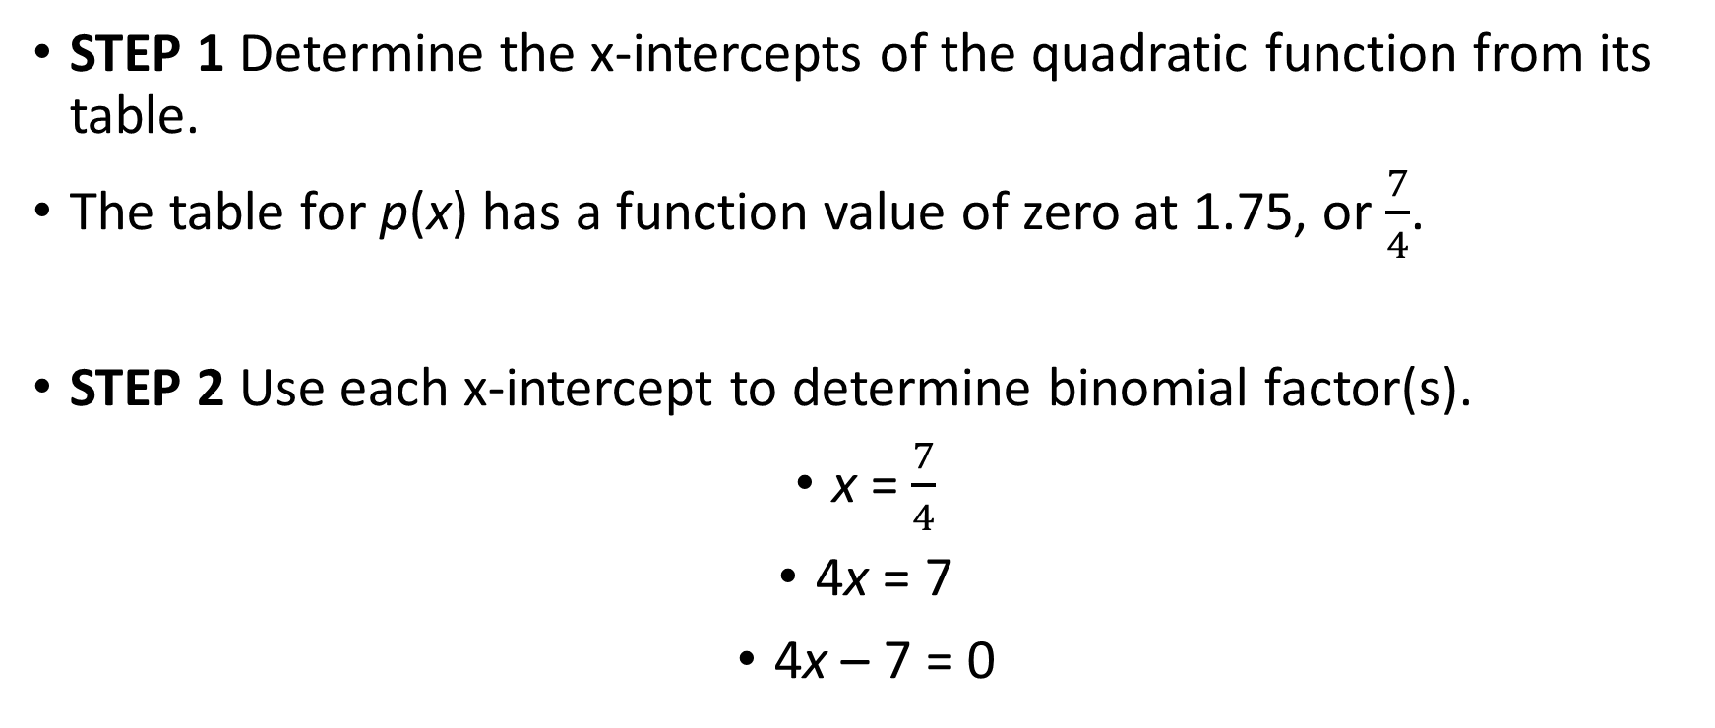
Examples
STEP 1 Determine the x-intercepts of the quadratic function from its table.
The table for p(x) has a function value of zero at 1.75, or $\frac{7}{4}$.
STEP 2 Use each x-intercept to determine binomial factor(s).
x = $\frac{7}{4}$
4x = 7
4x – 7 = 0

Slide 14
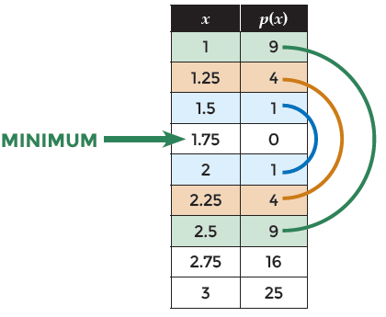
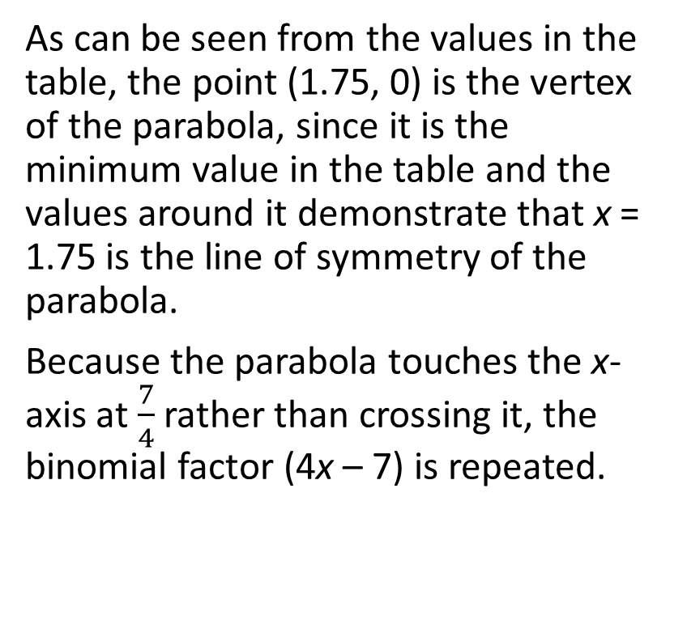
Examples
As can be seen from the values in the table, the point (1.75, 0) is the vertex of the parabola, since it is the minimum value in the table and the values around it demonstrate that x = 1.75 is the line of symmetry of the parabola.
Because the parabola touches the x-axis at $\frac{7}{4}$ rather than crossing it, the binomial factor (4x – 7) is repeated.

Slide 15
Examples
STEP 3 Multiply the binomial factors and compare to the symbolic representation of p(x).
Use the function builder in the calculator to check against the original function.
STEP 4 Write the function as a product of its binomial factors.
p(x) = (4x – 7)(4x – 7)
p(x) = (4x – 7)²

