Slide 1
Writing Linear Equations

Slide 2
Linear Function
A linear function can be described by a linear equation.
You can use function notation to show that the output value of the function f, written f(x), corresponds to the input value x.

Slide 3
Linear Function
Linear functions are functions with a constant rate of change and can be written in the form f(x) = mx + b, where x is the independent variable and m and b are constants.
The graph of a linear function is a straight line made up of the set of all points that satisfy y = f(x).

Slide 4
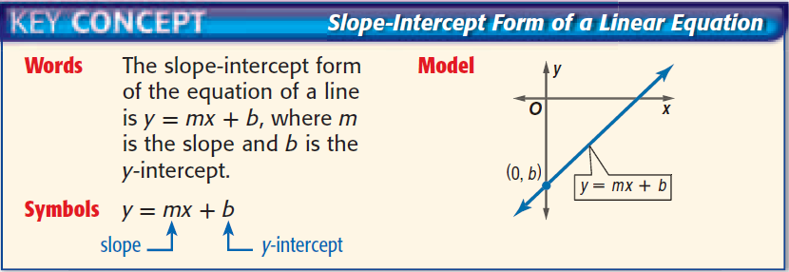
Slope-Intercept Form
An equation written in the form y = mx + b

Slide 5

Examples
Write an equation in slope-intercept form for the line that has a slope of -$\frac{3}{2}$ and passes through (-4, 1)

Slide 6

Examples
Write an equation in slope-intercept form for the line that has a slope of -$\frac{3}{2}$ and passes through (-4, 1)
y = mx + b
1 = -$\frac{3}{2}$ (-4) + b
1 = 6 + b
-5 = b
y = -$\frac{3}{2}$ x – 5

Slide 7

Examples
Write an equation in slope-intercept form for the line that has a slope of $\frac{4}{3}$ and passes through (3, 2)

Slide 8

Examples
Write an equation in slope-intercept form for the line that has a slope of $\frac{4}{3}$ and passes through (3, 2)
y = mx + b
2 = $\frac{4}{3}$ (3) + b
2 = 4 + b
-2 = b
y = $\frac{4}{3}$ x – 2

Slide 9
Examples
Write an equation in slope-intercept form for the line that has a slope of -4 and passes through (-2, -2)

Slide 10
Examples
Write an equation in slope-intercept form for the line that has a slope of -4 and passes through (-2, -2)
y = mx + b
-2 = -4(-2) + b
-2 = 8 + b
-10 = b
y = -4x – 10

Slide 11
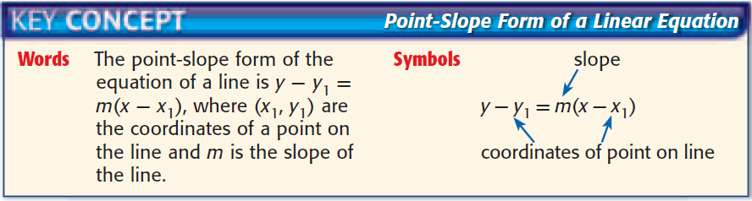
Point-Slope Form
An equation written in the form y – y₁ = m(x – x₁)

Slide 12
Examples
Write an equation in slope-intercept form for the line that passes through (2, 3) and (-4, -5)

Slide 13

Examples
Write an equation in slope-intercept form for the line that passes through (2, 3) and (-4, -5)
m = $\frac{y2 −y1}{x2 −x1}$ y = $\frac{4}{3}$x – $\frac{8}{3}$ + 3
m = $\frac{−5 −3}{−4−2}$ = $\frac{−8}{−6}$ = $\frac{4}{3}$ y = $\frac{4}{3}$x – $\frac{8}{3}$ + $\frac{9}{3}$
y – y₁ = m(x – x₁) y = $\frac{4}{3}$x + $\frac{1}{3}$
y – 3 = $\frac{4}{3}$(x – 2)
y – 3 = $\frac{4}{3}$x – $\frac{8}{3}$

Slide 14
Examples
Write an equation in slope-intercept form for the line that passes through (6, 1) and (8, -4)

Slide 15

Examples
Write an equation in slope-intercept form for the line that passes through (6, 1) and (8, -4)
m = $\frac{y2 −y1}{x2 −x1}$ y = $\frac{−5}{2}$x + 15+ 1
m = $\frac{−4 −1}{8−6}$ = $\frac{−5}{2}$ y = $\frac{−5}{2}$x + 16
y – y₁ = m(x – x₁)
y – 1 =$\frac{−5}{2}$(x – 6)
y – 1 = $\frac{−5}{2}$x + $\frac{30}{2}$

Slide 16
Parallel and Perpendicular Lines
We can use the slope-intercept and point-slope forms to write equations of lines that are parallel or perpendicular to other lines.

Slide 17
Parallel Lines
Parallel lines are lines that lie in the same plane and do not intersect.
Parallel lines have the same slope.

Slide 18

Examples
Write an equation for the line that passes through (4, 6) and is parallel to the graph of y = $\frac{2}{3}$x + 5.

Slide 19

Examples
Write an equation for the line that passes through (4, 6) and is parallel to the graph of y = $\frac{2}{3}$x + 5.
m = $\frac{2}{3}$, p(4, 6) y = $\frac{2}{3}$x – $\frac{8}{3}$ + 6
y – y₁ = m(x – x₁) y = $\frac{2}{3}$x – $\frac{8}{3}$ + $\frac{18}{3}$
y – 6 = $\frac{2}{3}$(x – 4) y = $\frac{2}{3}$x + $\frac{10}{3}$
y – 6 = $\frac{2}{3}$x – $\frac{8}{3}$

Slide 20
Perpendicular Lines
Perpendicular lines are lines that lie in the same plane and intersect at right angles.
Two lines are perpendicular if the product of their slopes is -1.
Two lines are perpendicular if the slopes are negative reciprocals.

Slide 21
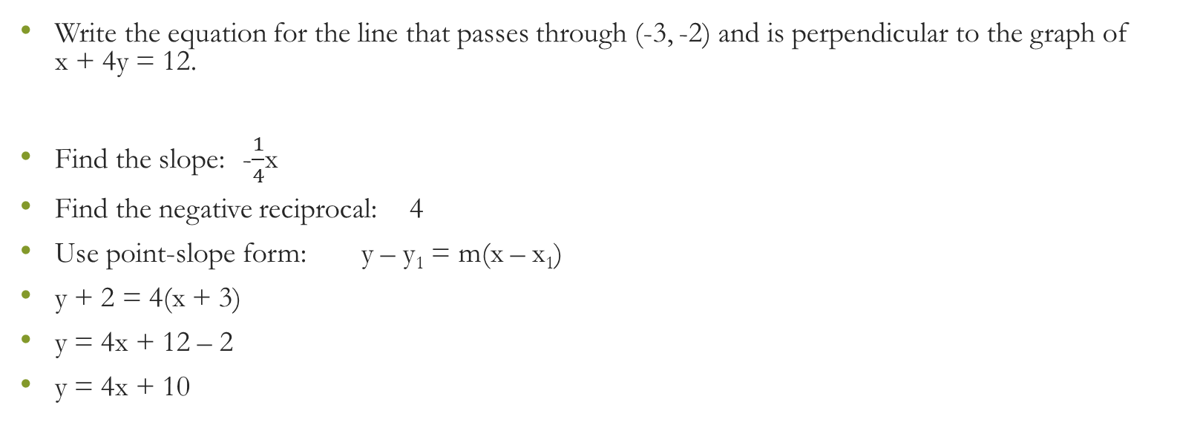
Examples
Write the equation for the line that passes through (-3, -2) and is perpendicular to the graph of x + 4y = 12.
Find the slope: -$\frac{1}{4}$x
Find the negative reciprocal: 4
Use point-slope form: y – y₁ = m(x – x₁)
y + 2 = 4(x + 3)
y = 4x + 12 – 2
y = 4x + 10

