Slide 1
Graphing Linear Functions

Slide 2
Graphing Linear Functions
A linear equation is an equation whose graph is a line. The solutions of a linear equation are the points that make up its graph.

Slide 3
Examples
Use the table to make a graph and to write and equation.

Slide 4
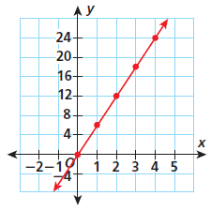
Examples
Use the table to make a graph and to write and equation.
y = 6x

Slide 5
Examples
Graph y = 2x + 1

Slide 6
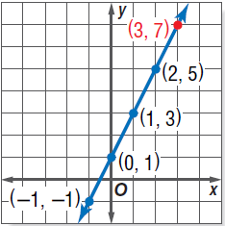
Examples
x | y
-1 | 5
0 | 1
1 | 3
2 | 5
Graph y = 2x + 1
Start by making a table.
Then graph the points.

Slide 7
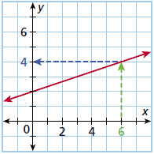
Examples
Use a graph of the function f(x) = $\frac{1}{3}$x + 2 to find the value of f(x) when x = 6. Check your answer.
Locate 6 on the x axis.
Move up from the 6 to the graph.
Find the corresponding value of y.
Use substitution to check.

