Slide 1
Parallel Lines and Transversals
Angles and Parallel Lines

Slide 2
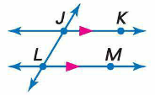
Parallel Lines
Parallel lines are coplanar lines that do not intersect

Slide 3
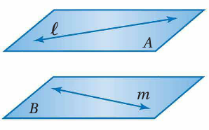
Skew Lines
Skew lines are lines that do not intersect and are not coplanar.

Slide 4
Parallel Planes
Parallel planes are planes that do not intersect.

Slide 5
Examples

Slide 6
Transversals
A transversal is a line that intersects two or more coplanar lines at two different points.

Slide 7
Transversal Angle Pair Relationships

Slide 8
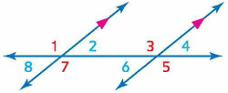
Corresponding Angles Postulate
If two parallel lines are cut by a transversal, then each pair of corresponding angles is congruent

Slide 9
Parallel Lines and Angle Pairs

Slide 10
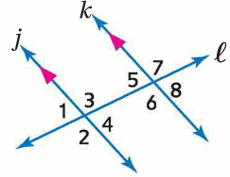
Examples
If m∠2 = 4x + 7 and m∠7 = 5x – 13, find x

Slide 11
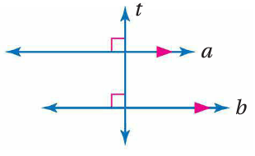
Perpendicular Transversal Theorem
In a plane, if a line is perpendicular to one of two parallel lines, then it is perpendicular to the other.

Slide 12
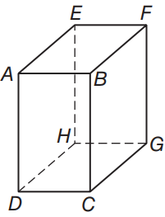
Examples
Identify all planes parallel to plane DEH.

Slide 13
Examples
Identify all segments parallel to plane AB.

Slide 14
Examples
Identify all segments that intersect GH.

Slide 15
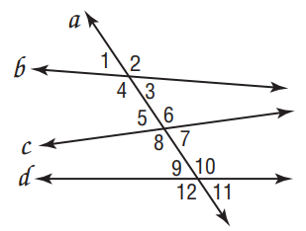
Examples
Classify each pair of angles as alternate interior, alternate exterior, corresponding, or consecutive interior angles.
∠4 and ∠5

Slide 16
Examples
Classify each pair of angles as alternate interior, alternate exterior, corresponding, or consecutive interior angles.
∠3 and ∠6

Slide 17
Examples
Classify each pair of angles as alternate interior, alternate exterior, corresponding, or consecutive interior angles.
∠7 and ∠11

Slide 18
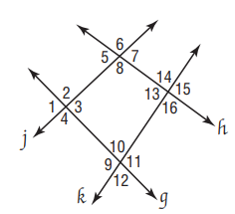
Examples
Indentify the transversal connecting each pair of angles. Then classify the relationship between each pair of angles.
∠2 and ∠12

Slide 19
Examples
Indentify the transversal connecting each pair of angles. Then classify the relationship between each pair of angles.
∠13 and ∠10

Slide 20
Examples
Indentify the transversal connecting each pair of angles. Then classify the relationship between each pair of angles.
∠6 and ∠14

Slide 21
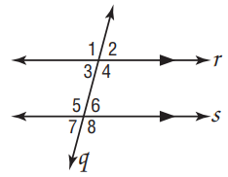
Examples
If m∠2 = 70, find the measure of each angle.
∠3

Slide 22
Examples
If m∠2 = 70, find the measure of each angle.
∠1

Slide 23
Examples
If m∠2 = 70, find the measure of each angle.
∠6

Slide 24
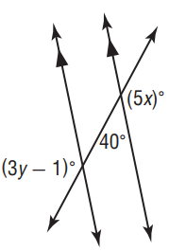
Examples
Find the value of the variables in the figure.

Slide 25
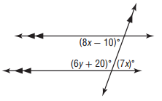
Examples
Find the value of the variables in the figure.

Slide 26
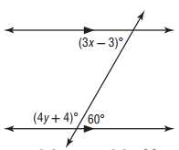
Examples
Find the value of the variables in the figure.

