Slide 1
Proving Lines Parallel
Perpendiculars and Distance

Slide 2
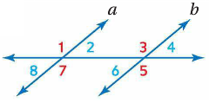
Converse of Corresponding Angles
If two lines are cut by a transversal so that corresponding angles are congruent, then the lines are parallel.

Slide 3
Parallel Postulate
If given a line and a point not on the line, then there exists exactly one line through the point that is parallel to the given line.

Slide 4
Theorems

Slide 5
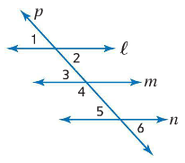
Examples
Determine which lines, if any, are parallel. State the postulate or theorem that justifies your answer.
∠1 ≅ ∠6

Slide 6
Examples
Determine which lines, if any, are parallel. State the postulate or theorem that justifies your answer.
∠2 ≅ ∠3

Slide 7
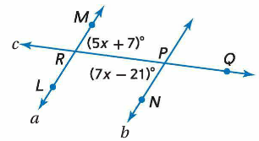
Examples
Find m∠MRQ so that a ∥ b.

Slide 8
Examples
Find m∠MRQ so that a ∥ b.
Alt. Int. Angles
5x + 7 = 7x – 21
28 = 2x
14 = x

Slide 9
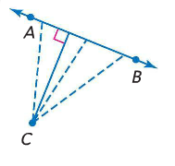
Perpendiculars and Distance
The distance between a line and a point not on the line is the length of the segment perpendicular to the line from the point.

Slide 10
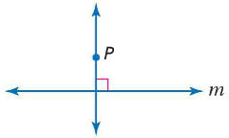
Perpendicular Postulate
If given a line and a point not on the line, then there exists exactly one line through the point that is perpendicular to the given line.

Slide 11
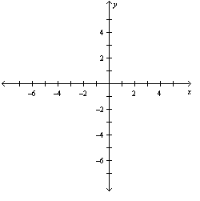
Examples
Line l contains points at (-5, 3) and (4, -6). Find the distance between line l and point P(2, 4).

Slide 12
Examples
Line l contains points at (-5, 3) and (4, -6). Find the distance between line l and point P(2, 4).
x: 4 units
y: 4 units
distance is √(4² + 4²) = √32 = 4 √2

Slide 13
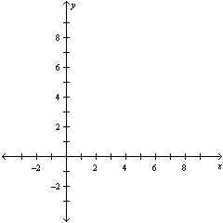
Examples
Line l contains points at (1, 2) and (5, 4). Construct a line perpendicular to l through P(1, 7). Then find the distance from P to l.

Slide 14
Examples
Line l contains points at (1, 2) and (5, 4). Construct a line perpendicular to l through P(1, 7). Then find the distance from P to l.
x: 2 units
y: -4 units
distance is √(2² + 4²) = √20 = 2 √5

Slide 15
Theorem
In a plane, if two lines are each equidistant from a third line, then the two lines are parallel to each other.

Slide 16
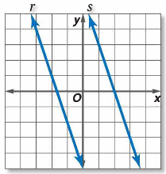
Examples
Find the distance between the parallel lines r and s whose equations are y = -3x – 5 and y = -3x + 6, respectively.

Slide 17
Examples
Find the distance between the parallel lines r and s whose equations are y = -3x – 5 and y = -3x + 6, respectively.
m⊥= 1/3
point = (-2, 1)

