Slide 1
Inductive Reasoning and Conjecture, and Logic

Slide 2
Inductive Reasoning
Reasoning that uses examples to come to a conclusion; think patterns
A concluding statement based on inductive reasoning is called a conjecture; think educated guess

Slide 3
Examples
The sum of two even numbers
The relationship between AB and EF if AB = CD and CD = EF

Slide 4
Counterexamples
A false example; it can be a number, a drawing, or a statement.
Ex. – 2x > x; false if x < 0

Slide 5
Examples
3, 3, 6, 9, 15,… what is the next number?
What is next in the sequence?
If in ∆ABC, (AB)² + (BC)² = (AC)^{2,} then ∆ABC is a right triangle

Slide 6
Logic
Statement is a sentence that is either true or false.
Truth value of a statement is either true (T) or false (F)
Negation of a statement has the opposite meaning and truth value; written p, read not p

Slide 7
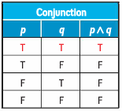
Logic
A compound statement using the word and is called a conjunction; written , read p and q
Conjunctions are only true when both statements are true

Slide 8
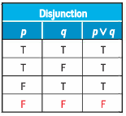
Logic
A compound statement using the word or is called a disjunction; written , read p or q
Disjunctions are only false when both statements are false

Slide 9
Truth Table
Truth tables organize the values of statements
Start by making columns with heading that include each original statement, any negations of the statements, and the compound statements
Next, determine all of the possible combinations of truth values… 2^{x}, where x is the number of original statements

Slide 10
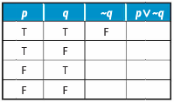
Truth Table
Use the truth values to determine each part of the compound statement to determine the truth value of the statement.

Slide 11
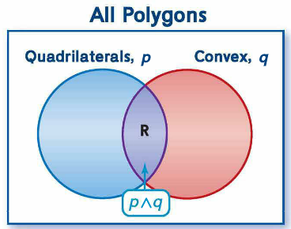
Venn Diagrams
Conjunctions and disjunctions can also be illustrated with Venn diagrams.
Rectangles are located at the intersection of the set of quadrilaterals and the set of convex polygons

Slide 12
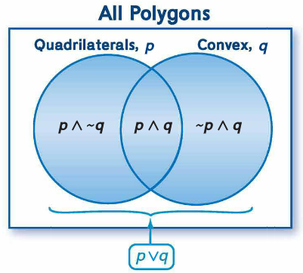
Venn Diagrams
A disjunction is represented by the union of the two sets; all polygons that are quadrilaterals, convex or both.
The disjunction includes three regions: quadrilaterals that are not convex, convex polygons that are not quadrilaterals, and polygons that are both quadrilaterals and convex

Slide 13
Examples

Slide 14
Examples

Slide 15
Examples

Slide 16
Questions
How are truth tables useful in the real world?
How can you as a student use Venn diagrams in your life?

