Slide 1
Solving Inequalities

Slide 2
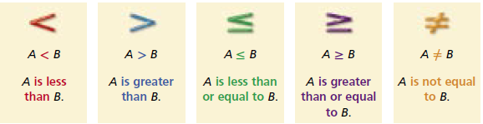
Inequality
An inequality is a statement that compares two expressions by using the symbols <, >, ≤, ≥, or ≠.
It says that two quantities are not equal.

Slide 3
Trichotomy Property
For any two real numbers, a and b, exactly one of the following statements is true:
a < b a = b a > b
Adding or subtracting the same number on each side of an inequality does not change the truth of the inequality.

Slide 4
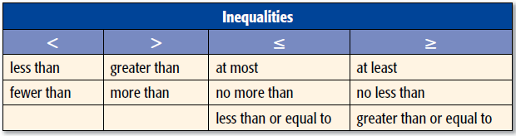
Phrases of Inequality
The chart shows some common phrases that indicate inequalities in word problems.

Slide 5
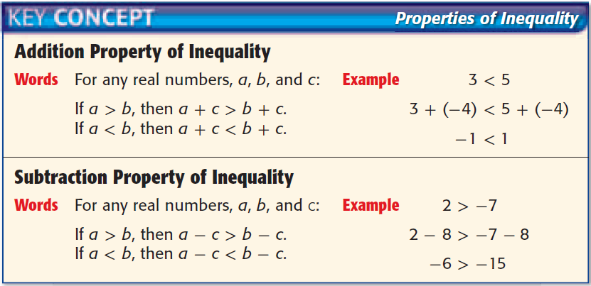
Properties of Inequality

Slide 6
Examples
Solve t – 45 ≤ 13. Check your solution.

Slide 7
Examples
Solve t – 45 ≤ 13. Check your solution.
t – 45 ≤ 13
t – 45 + 45 ≤ 13 + 45
t ≤ 58
Check: use 58, a number greater than 58, and a number less than 58

Slide 8
Examples
Solve s +19 > 56. Check your solution.

Slide 9
Examples
Solve s +19 > 56. Check your solution.
s +19 > 56
s +19 – 19 > 56 – 19
s > 37
Check: a number greater than 37, and a number less than 37

Slide 10
Properties of Equality
If you multiply or divide both sides by a negative number, you must reverse the inequality symbol.

Slide 11
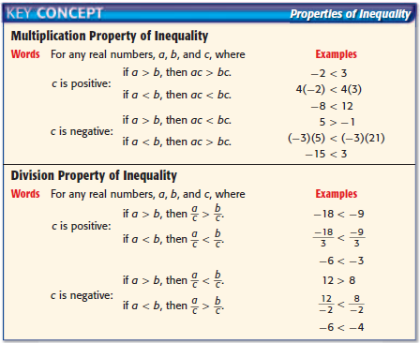
Properties of Inequality

Slide 12

Examples
Solve $\frac{1}{4}n$ > 750.

Slide 13

Examples
Solve $\frac{1}{4}n$ > 750.
$\frac{1}{4}n$ > 750
4 * $\frac{1}{4}n$ > 4 * 750
$n$ > 3000

Slide 14

Examples
Solve - $\frac{2}{5}p$ < -14.

Slide 15

Examples
Solve - $\frac{2}{5}p$ < -14.
- $\frac{2}{5}p$ < -14
- $\frac{5}{2}∗$-$\frac{2}{5}$p > - $\frac{5}{2}∗$-14
$p$ > 35

Slide 16
Examples
Solve 14h > 91

Slide 17

Examples
Solve 14h > 91
14h > 91
$\frac{14h}{14}$ > $\frac{91}{14}$
h > 6.5

Slide 18

Examples
Solve -5t ≥ 275
-5t ≥ 275
$\frac{−5t}{−5}$ ≤ $\frac{275}{−5}$
t ≤ -55

Slide 19

Examples
Solve -m ≤ $\frac{m+4}{9}$

Slide 20

Examples
Solve -m ≤ $\frac{m+4}{9}$
-m ≤ $\frac{m+4}{9}$
-m * 9 ≤ $\frac{m+4}{9}$ * 9
-9m ≤ m + 4
-9m – m ≤ m – m + 4
-10m ≤ 4
$\frac{−10m}{−10}$ ≥ $\frac{4}{−10}$
m ≥ - $\frac{2}{5}$

